Slide 1

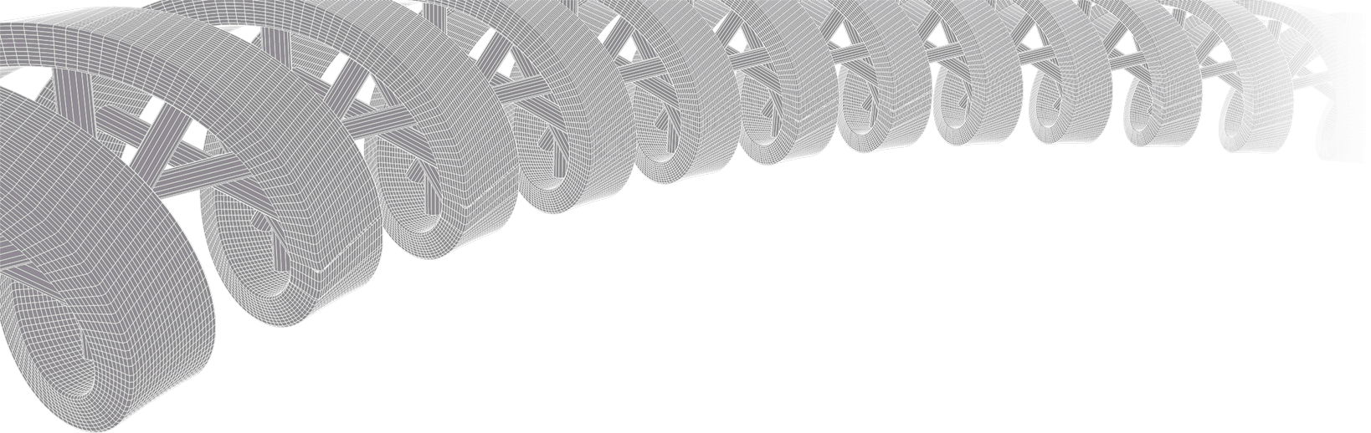
GenViz Module 1: Introduction to genomic data visualization and interpretation
Malachi Griffith, Obi Griffith, Zachary Skidmore
Genomic Data Visualization and Interpretation
September 11-15, 2017
Berlin

Slide 2
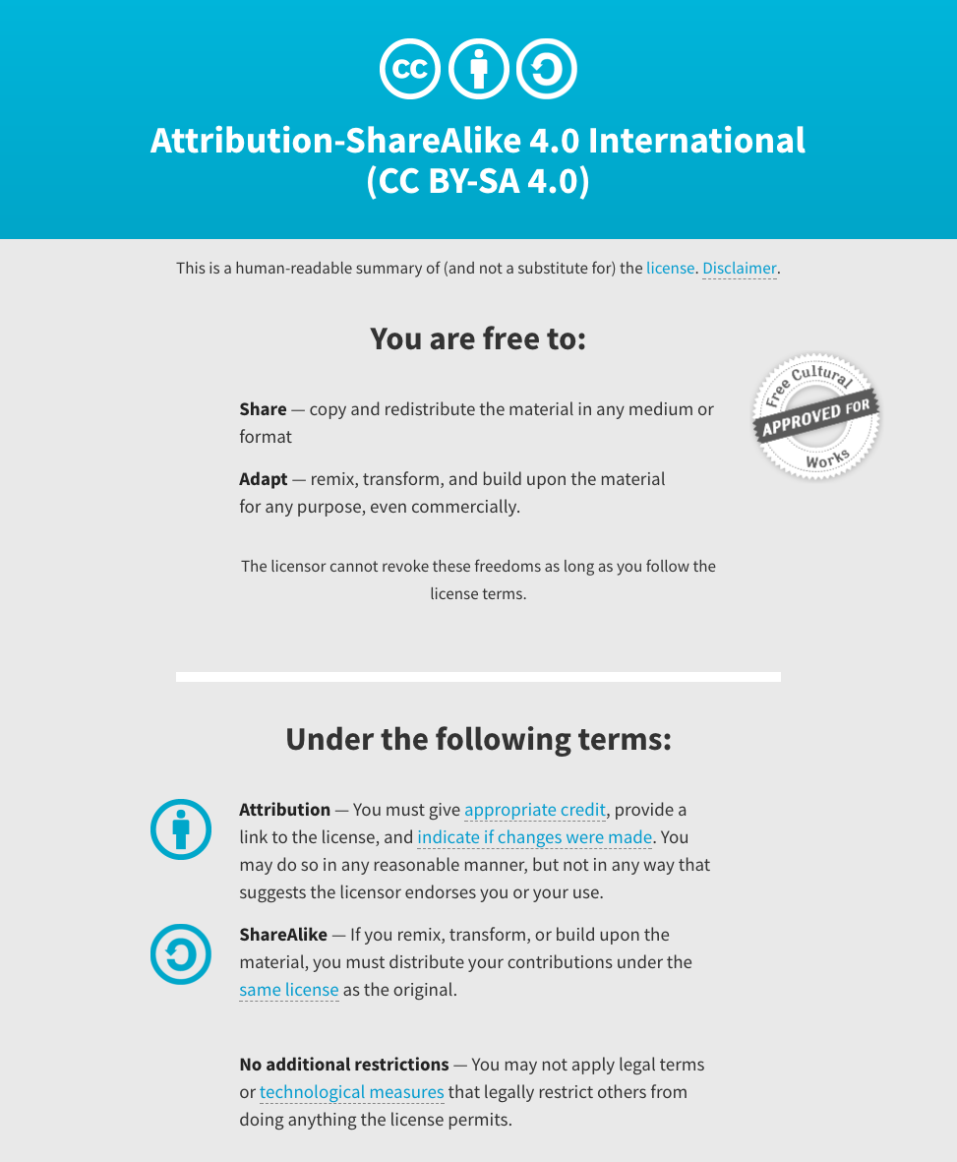
Notes:
Note there are two licenses if effect for this course.
All *content* (lectures, written materials, etc.) are made available under the Creative Commons Attribution-ShareAlike 4.0 International (CC BY-SA 4.0). (https://creativecommons.org/licenses/by-sa/4.0/).
All *code* (R scripts the website code itself) are made available under the MIT License (https://opensource.org/licenses/MIT).

Slide 3
Learning objectives of the course
Module 1: Introduction to genomic data visualization and interpretation
Module 2: Using R for genomic data visualization and interpretation
Module 3: Introduction to GenVisR
Module 4: Expression profiling, visualization, and interpretation
Module 5: Variant annotation and interpretation
Module 6: Q & A, discussion, integrated assignments, and working with your own data
Tutorials
Provide working examples of data visualization and interpretation
Self contained, self explanatory, portable

Slide 4
Learning objectives of module 1
Introduction to genomic data visualization and interpretation
Introduction
Central dogma
‘Omics technologies
Common genomic file formats
Genome annotation resources
Common problems
Genome browsers
Fundamentals of data visualization
Best practices in visualization
Examples of visualization in R

Slide 5
Why do we create visualizations of genomic data?
Data exploration and interpretation of results
QC analysis
Understanding whether/how an experiment worked
Discovery
Communication
Slides for presentations
e.g. Keynote, Powerpoint, etc.
Figures for publications
e.g. PDFs, PNGs, etc.

Slide 6
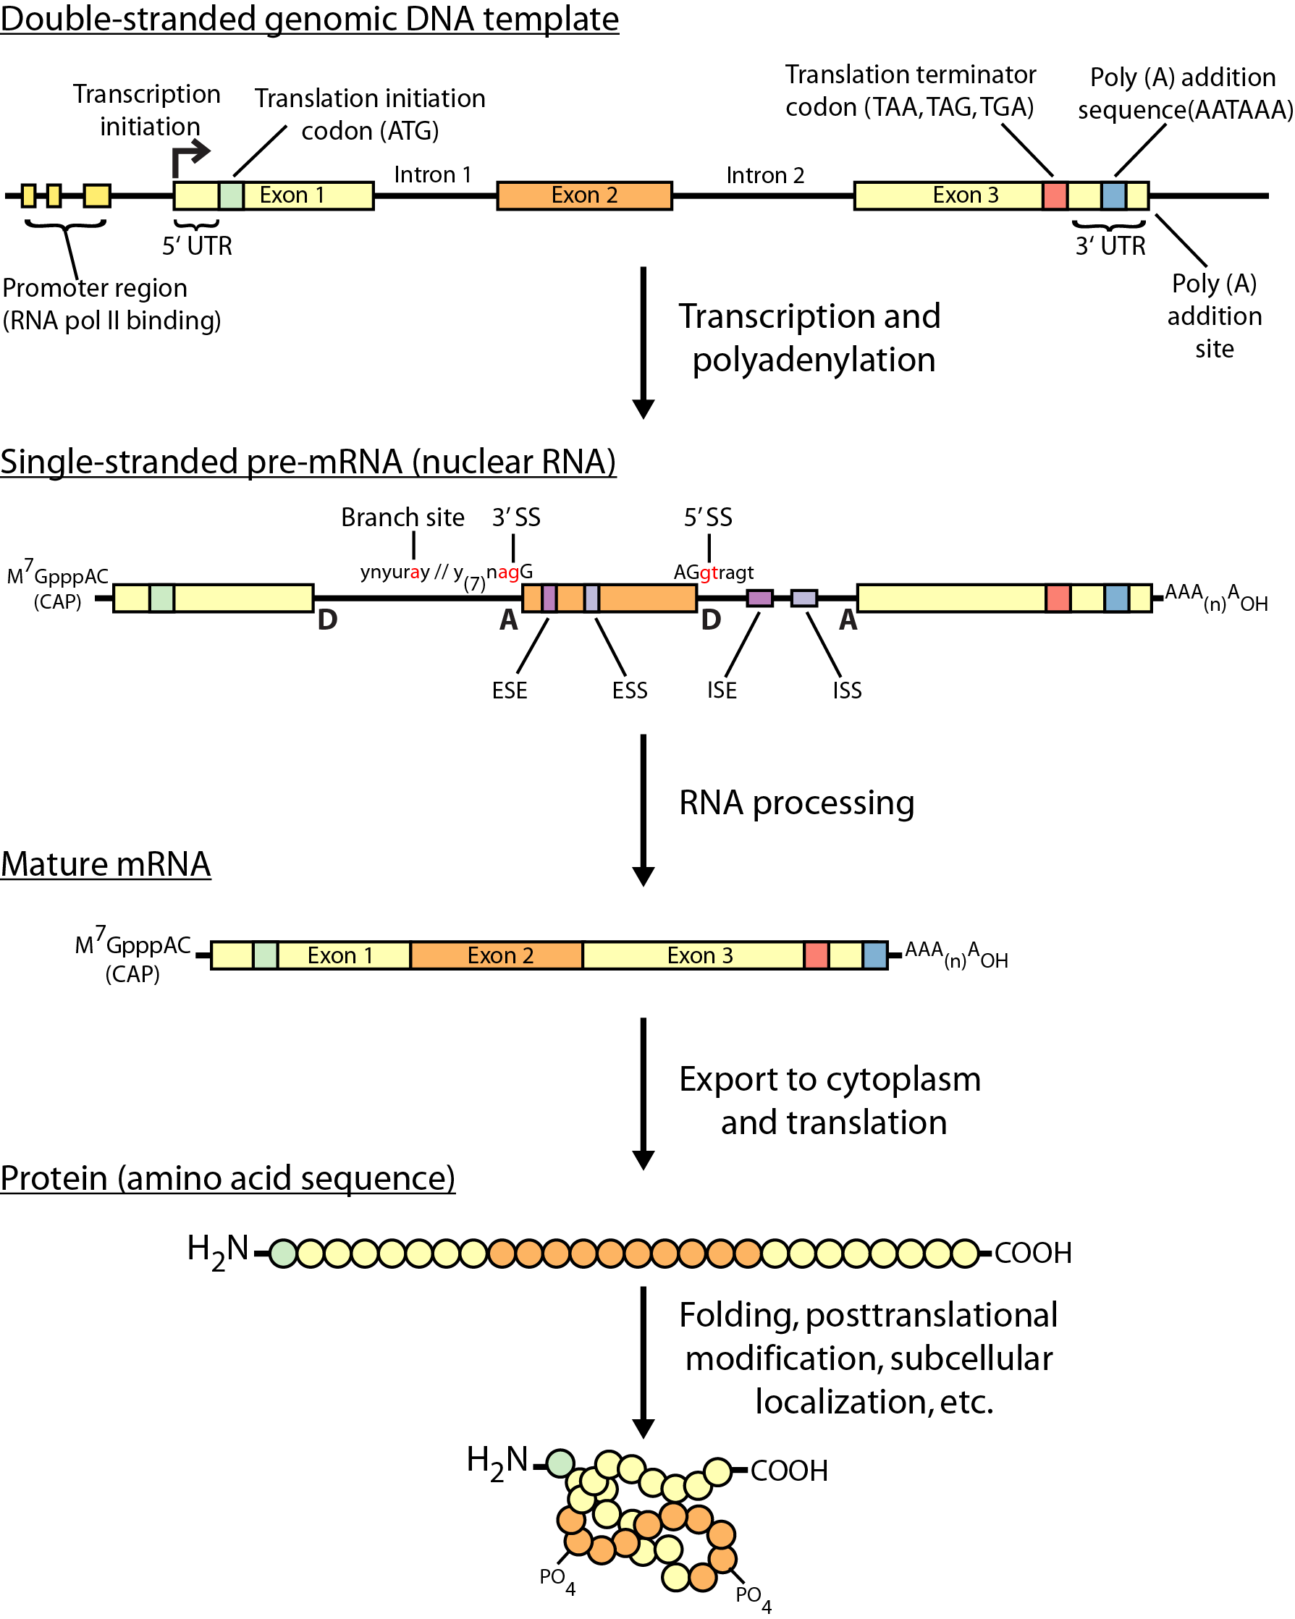
Review of central dogma

Slide 7
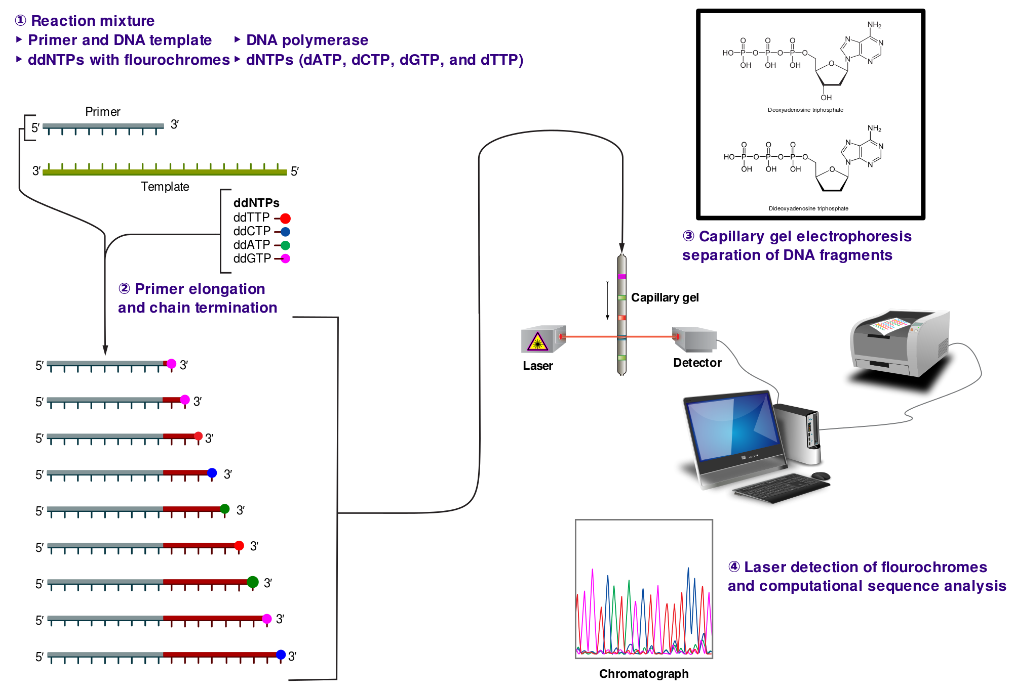
Non-parallel (Sanger) sequencing
Notes:
ddNTP = dideoxy nucleoside triphosphate
dNTP = deoxy nucleoside triphosphate

Slide 8
Non-parallel (Sanger) sequencing
Notes:
ddNTP = dideoxy nucleoside triphosphate
dNTP = deoxy nucleoside triphosphate

Slide 9
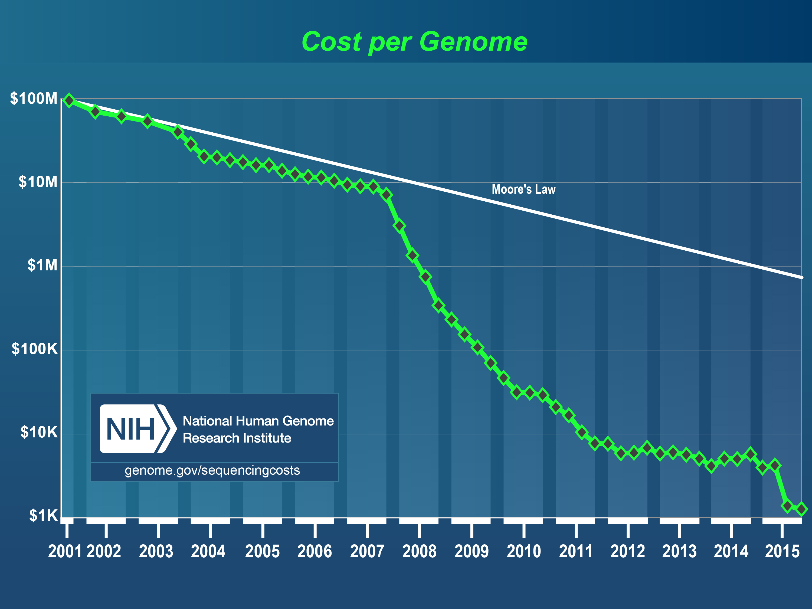
Costs of sequencing a human genome have plummeted from $100M to $1000

Slide 10
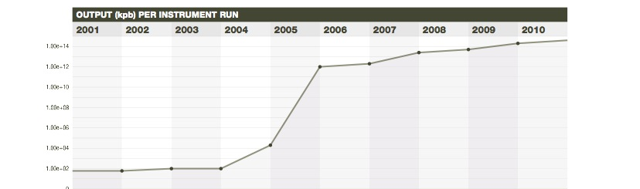
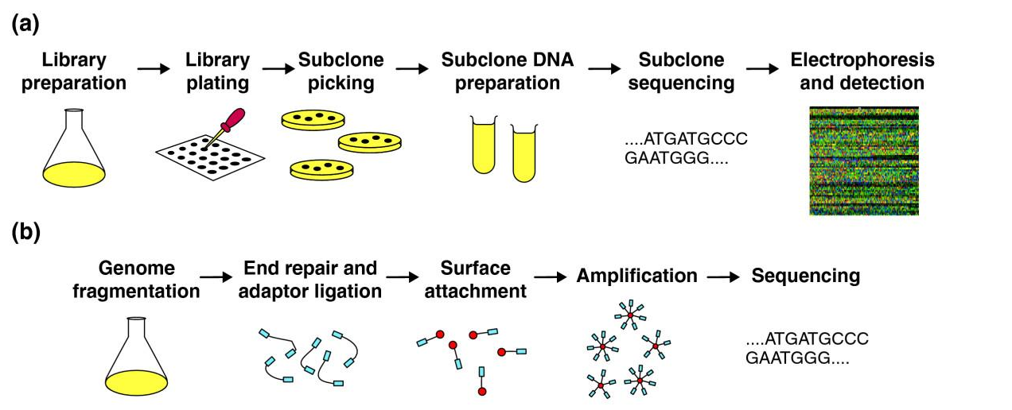
Massively parallel sequencing (NGS) has transformed biomedical inquiry
From 100s of reads to millions+
E.R. Mardis, Nature (2011) 470: 198-203, Ann. Rev. Analyt. Chem. (2013)
Notes:
DNA sequencing capabilities have changed radically since 2005, with the introduction of next-generation or “massively parallel” sequencing instruments. These differ fundamentally from capillary/Sanger methods because the up-front processes required of the latter, such as subcloning, picking of colonies, DNA isolation, and DNA sequencing reaction preparation are no longer needed (top panel). Rather, the massively parallel methods sequence the randomly fragmented, adapter ligated “library” fragments in a stepwise method that intercalates DNA sequencing steps with detection steps. This so-called massively parallel method means that a single human genome can be sequenced in a matter of days to produce the data required to characterize that genome by comparison to the human reference genome.

Slide 11
Massively Parallel DNA sequencing instruments
All MPS platforms require a library obtained either by amplification or ligation with custom linkers (adapters)
Each library fragment is amplified on a solid surface (either bead or flat Si-derived surface) with covalently attached adapters that hybridize the library adapters
Direct step-by-step detection of the nucleotide base incorporated by each amplified library fragment set
Hundreds of thousands to hundreds of millions of reactions detected per instrument run = “massively parallel sequencing”
A “digital” read type that enables direct quantitative comparisons
Shorter read lengths than capillary sequencers

Slide 12
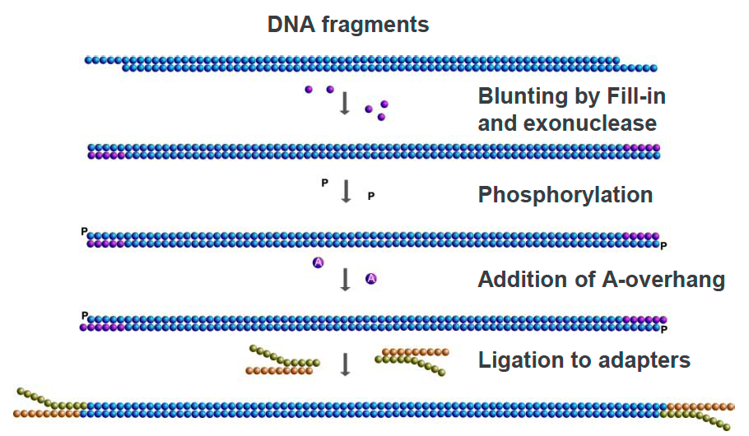
Library Construction for MPS
Shear high molecular weight DNA with sonication
Enzymatic treatments to blunt ends
Ligate synthetic DNA adapters (each with a DNA barcode), PCR amplify
Quantitate library
Proceed to WGS, or perform exome or specific gene hybrid capture

Slide 13
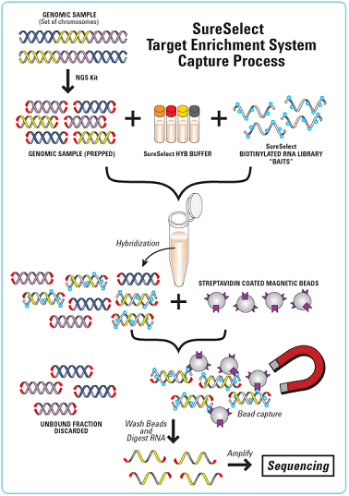
Hybrid Capture
Hybrid capture - fragments from a whole genome library are selected by combining with probes that correspond to most (not all) human exons or gene targets.
The probe DNAs are biotinylated, making selection from solution with streptavidin magnetic beads an effective means of purification.
An “exome” by definition, is the exons of all genes annotated in the reference genome.
Custom capture reagents can be synthesized to target specific loci that may be of clinical interest.

Slide 14
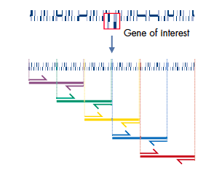
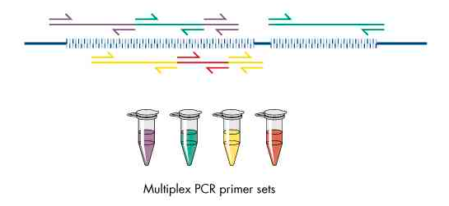
Multiplex PCR Amplification of Targets
Design amplification primer pairs for exons of genes of interest; tile primers to overlap fragments in larger exons
Group primer pairs according to G+C content, Tm and reaction condition specifics
Amplify genomic DNA to generate multiple products from each primer set; pool products from each set
Create library by ligation or tail platform adaptors on the primer ends
Sequence

Slide 15
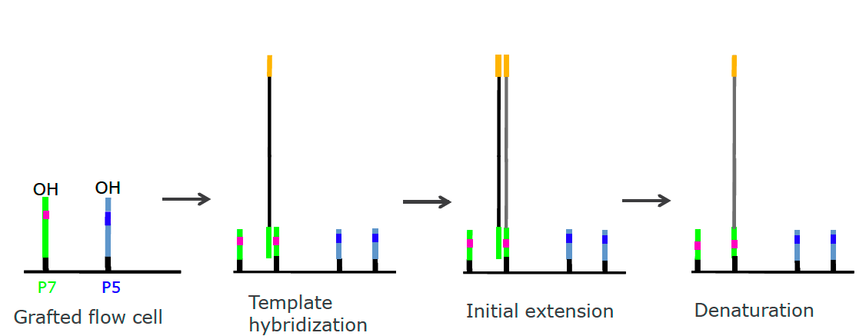
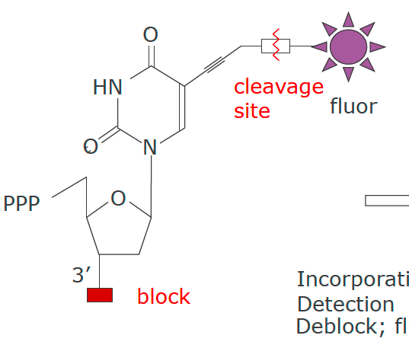
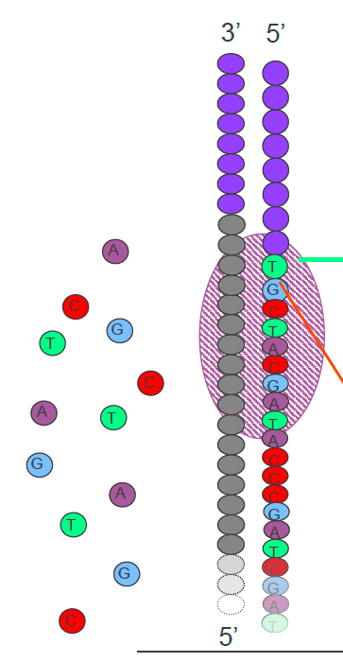
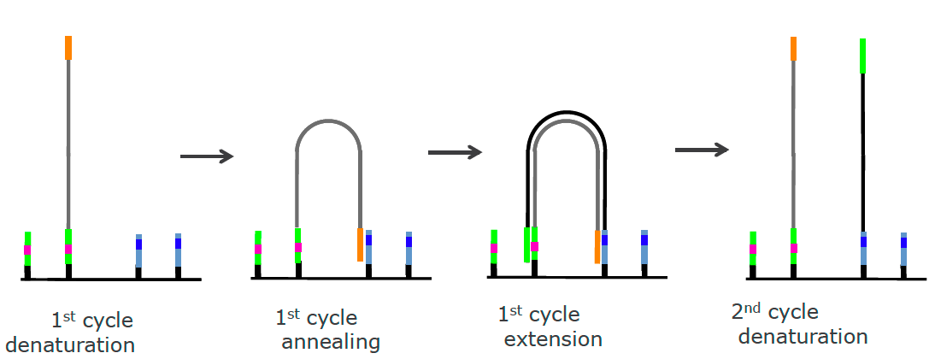
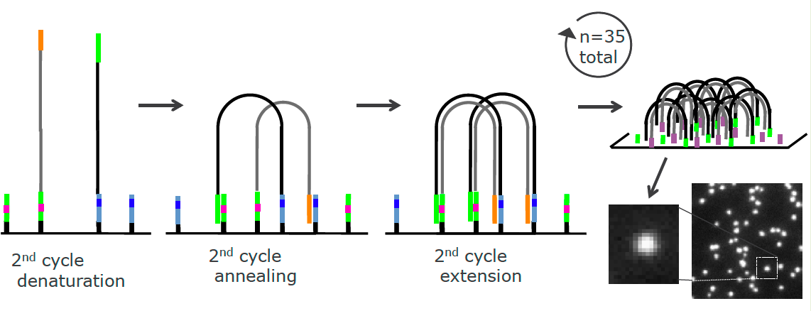
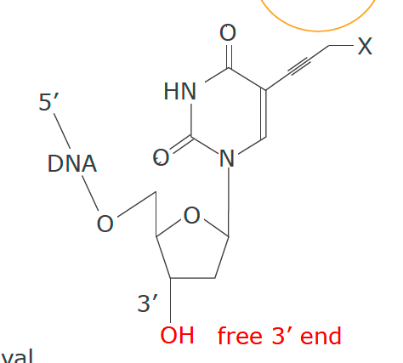
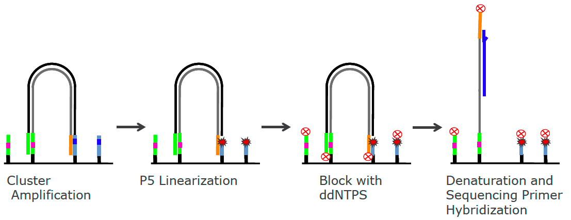
Illumina: Massively Parallel Sequencing by Synthesis
Emission
Incorporate
Detect
De-block
Cleave fluor
Excitation
Additional amplification on flowcell to form clusters

Slide 16
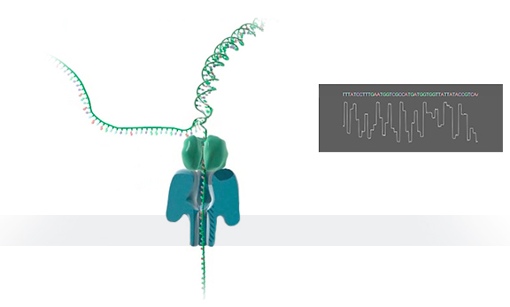
Platforms: Oxford Nanopore Sequencing
Protein nanopore set in an electrically
resistant polymer membrane
Each nanopore is controlled and measured
by a matched ASIC (Application Specific
Integrated Circuit)
Post-run data analysis compares pore current changes to a model of all possible multimers
Variable read lengths
Electrical current-based detection of multiplex nucleotides in pore
Error rate is around 10-20% with newest pore/software
Usage to-date is for bacterial and viral genome sequencing, RNA sequencing

Slide 17
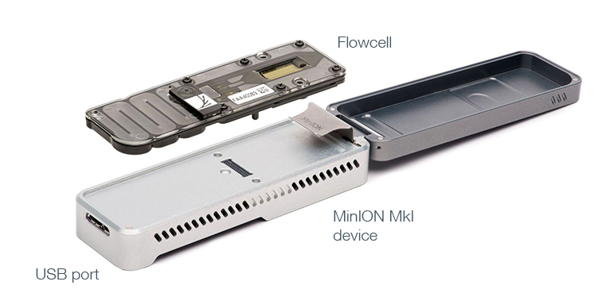
Nanopore Sequencing Devices
Commercially available
$1000 starter pack
512 pores
Simple 10-minute sample prep
10-40k reads
20—100MB per run
Size of a “usb stick”
Long reads (median 1kb, max ~100kb)
Relatively high error rate (38% in 2015)
Improving rapidly with 2D reads and other optimization

Slide 18
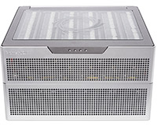
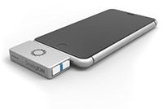
Future nanopore developments
promethION
smidgION
Early access
Price: TBD
48 x 3000 pores
Array of minions
In development
Smart-phone compatible

Slide 19
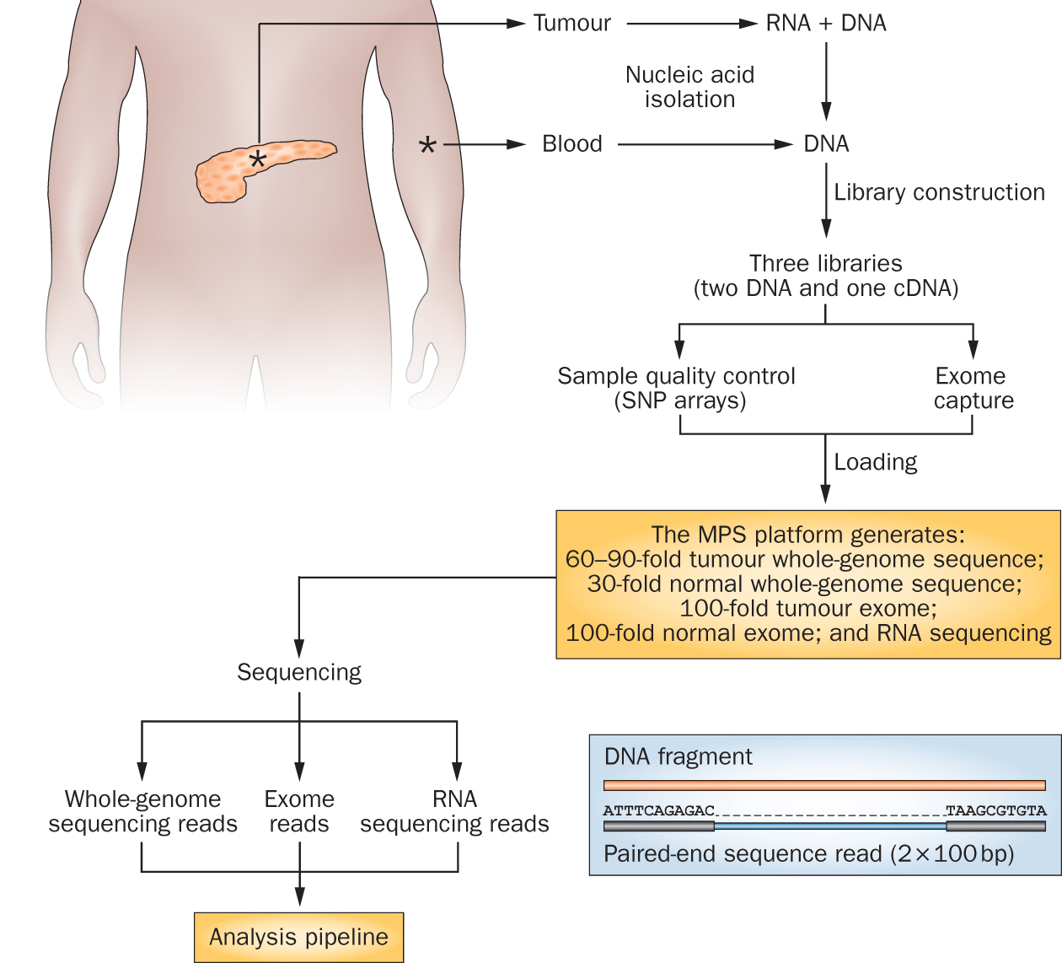
Genomics research has exploded with the rapid advances in DNA sequencing technologies
Notes:
We sequence a lot of things at the Genome Institute. But my research interest is fairly focused on clinical cancer sequencing. The idea here is that we start with a patient, sometimes starting at diagnosis but often starting at the point where they have exhausted standard of care options.
From these patients we get a tumor sample and a reference normal sample (usually blood). From the tumor we isolate DNA and RNA and from the normal we isolated DNA. This trio of samples is subjected to library construction followed by whole genome, exome, and transcriptome sequencing. This data flows into our analysis systems and we attempt to detect somatic events that might be relevant to cancer biology or treatment. This involves detecting single nucleotide variants, small insertions and deletions, large copy number amplifications and deletions, gene and isoform expression levels, structure rearrangements, expressed gene fusions, and detection of tumor associated viruses.

Slide 20
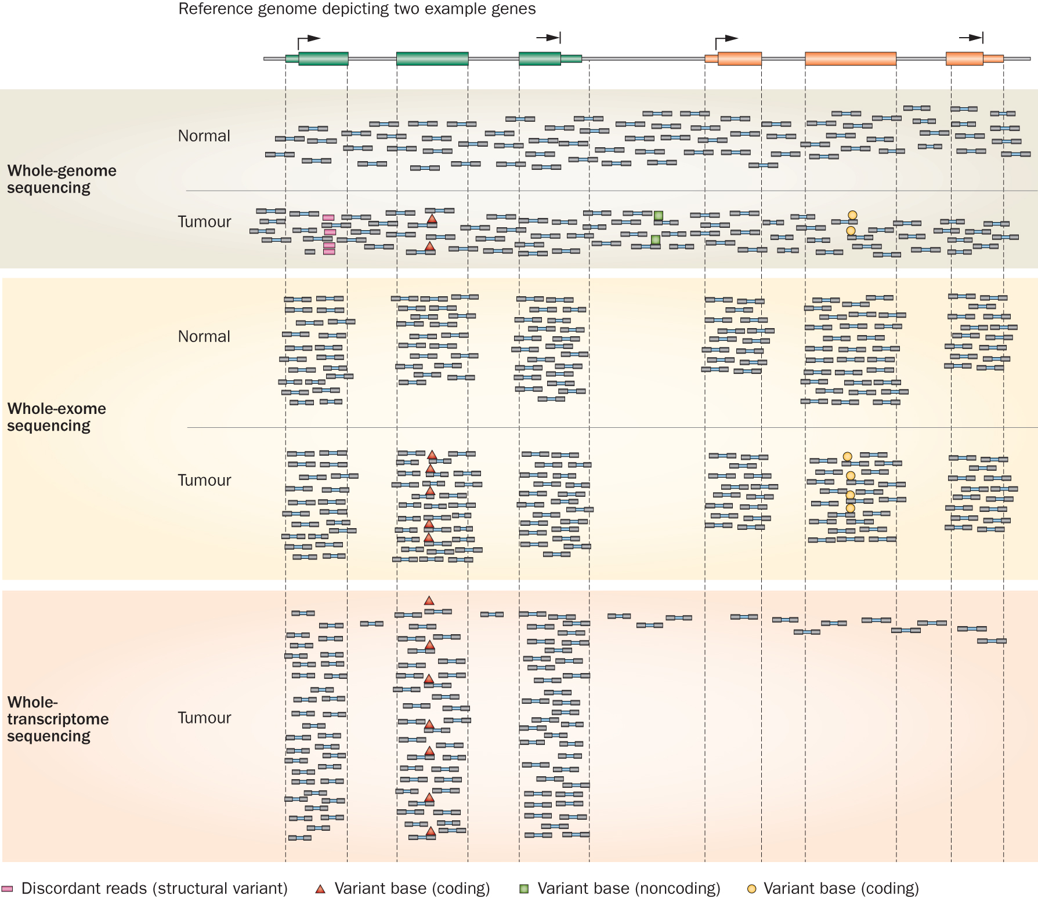
Whole genome, exome and transcriptome sequencing allows us to detect and confirm many different variant types
‘WGS’
‘Exome’
‘RNA-seq’
Notes:
Each of these three data types, whole genome, exome and transcriptome, brings something to the table.
Whole genome gives you broad, even, and relatively unbiased coverage across the genome.
Exome gives you more focused coverage but much greater depth over the exons for a much lower cost than whole genome
RNA-seq gives you a snapshot of the transcriptome.

Slide 21
Common genomic data file formats
FASTA
GTF
BED
VCF
VEP
MAF
SAM/BAM/CRAM
Many, many custom data formats output by specialized tools … often in TSV format

Slide 22
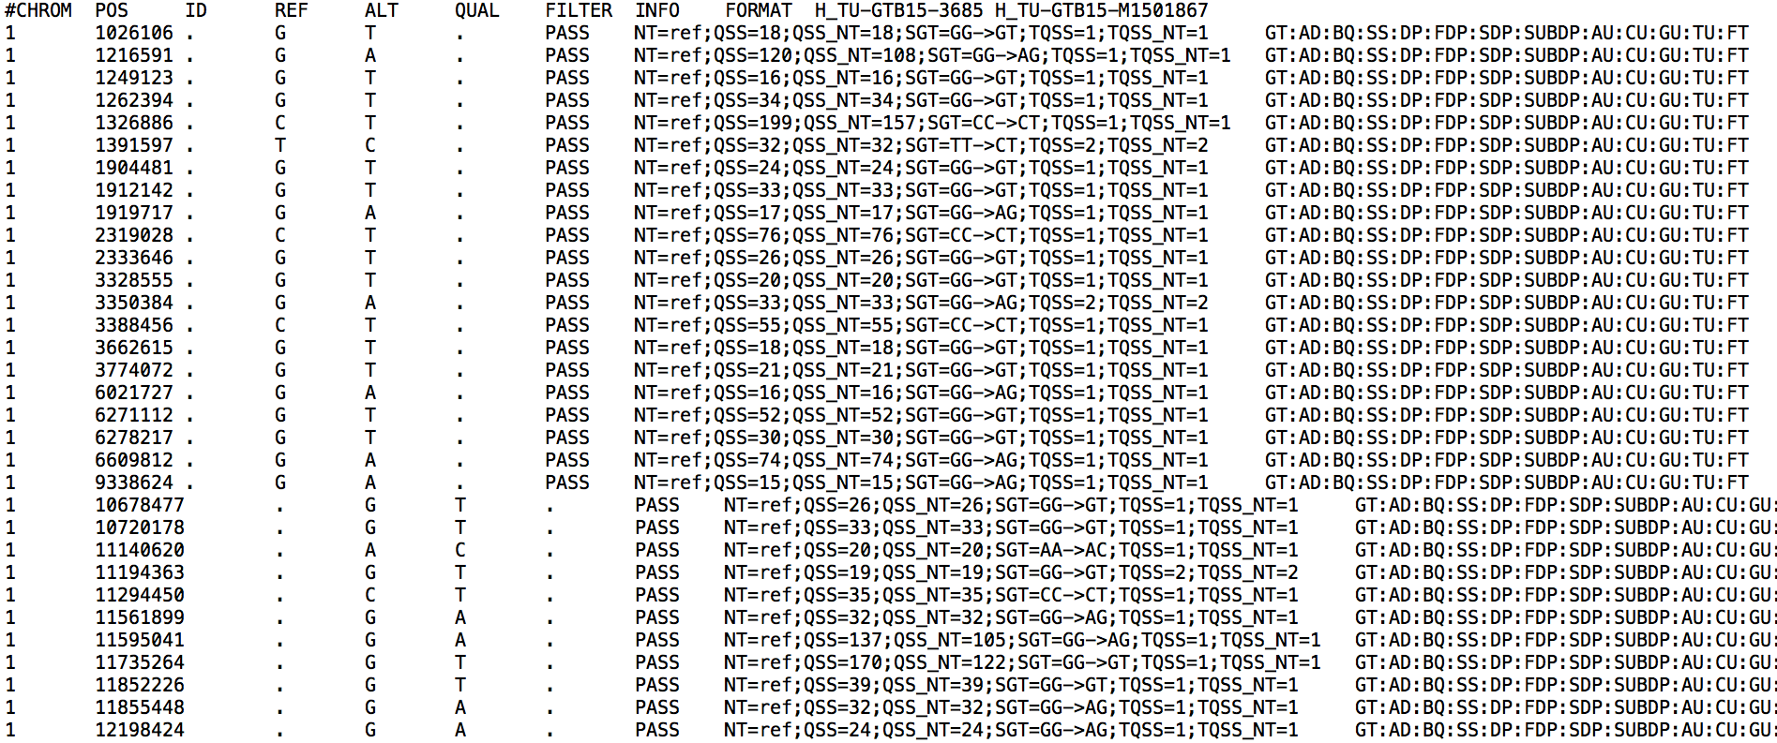
VCF file
Details of the VCF file format: hts-specs, VCF-v4.2.pdf

Slide 23
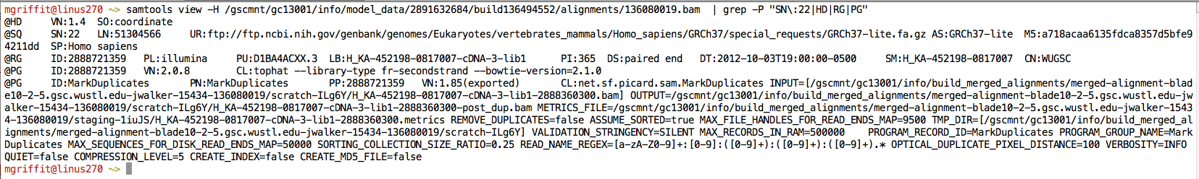
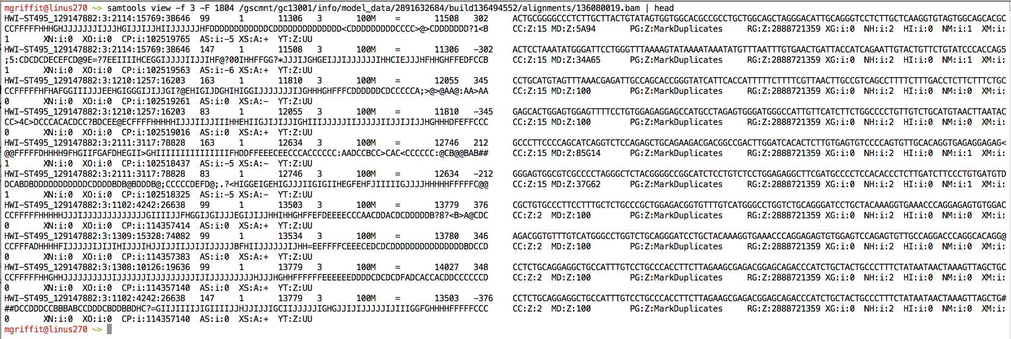
Example of SAM/BAM file format
Example SAM/BAM header section (abbreviated)
Example SAM/BAM alignment section (only 10 alignments shown)

Slide 24
Introduction to the SAM/BAM format
The specification
http://samtools.sourceforge.net/SAM1.pdf
The SAM format consists of two sections:
Header section
Used to describe source of data, reference sequence, method of alignment, etc.
Alignment section
Used to describe the read, quality of the read, and nature alignment of the read to a region of the genome
BAM is a compressed version of SAM
Compressed using lossless BGZF format
Other BAM compression strategies are a subject of research. See ‘CRAM’ format for example
BAM files are usually ‘indexed’
A ‘.bai’ file will be found beside the ‘.bam’ file
Indexing aims to achieve fast retrieval of alignments overlapping a specified region without going through the whole alignments. BAM must be sorted by the reference ID and then the leftmost coordinate before indexing

Slide 25
SAM/BAM header section
Used to describe source of data, reference sequence, method of alignment, etc.
Each section begins with character ‘@’ followed by a two-letter record type code. These are followed by two-letter tags and values
@HD The header line
VN: format version
SO: Sorting order of alignments
@SQ Reference sequence dictionary
SN: reference sequence name
LN: reference sequence length
SP: species
@RG Read group
ID: read group identifier
CN: name of sequencing center
SM: sample name
@PG Program
PN: program name
VN: program version

Slide 26
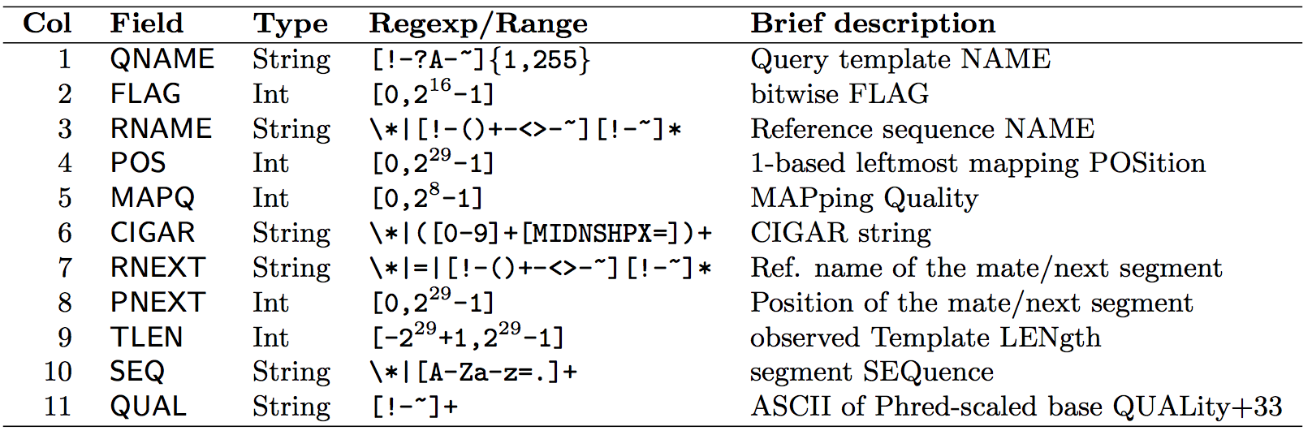
SAM/BAM alignment section
Example values
QNAME e.g. HWI-ST495_129147882:1:2302:10269:12362 (QNAME)
FLAG e.g. 99
RNAME e.g. 1
POS e.g. 11623
MAPQ e.g. 3
CIGAR e.g. 100M
RNEXT e.g. =
PNEXT e.g. 11740
TLEN e.g. 217
SEQ e.g. CCTGTTTCTCCACAAAGTGTTTACTTTTGGATTTTTGCCAGTCTAACAGGTGAAGCCCTGGAGATTCTTATTAGTGATTTGGGCTGGGGCCTGGCCATGT
QUAL e.g. CCCFFFFFHHHHHJJIJFIJJJJJJJJJJJHIJJJJJJJIJJJJJGGHIJHIJJJJJJJJJGHGGIJJJJJJIJEEHHHHFFFFCDCDDDDDDDB@ACDD

Slide 27
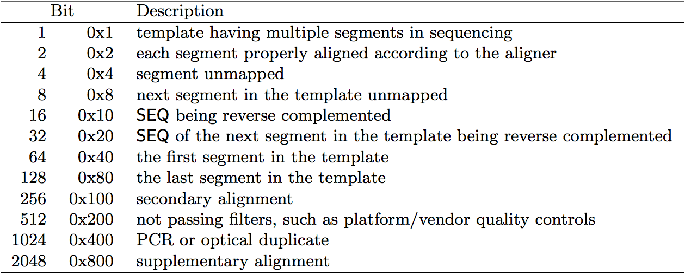
SAM/BAM flags explained
http://broadinstitute.github.io/picard/explain-flags.html
12 bitwise flags describing the alignment
These flags are stored as a binary string of length 11 instead of 11 columns of data
Value of ‘1’ indicates the flag is set. e.g. 00100000000
All combinations can be represented as a number from 1 to 2048 (i.e. 2¹¹-1). This number is used in the BAM/SAM file. You can specify ‘required’ or ‘filter’ flags in samtools view using the ‘-f’ and ‘-F’ options respectively
Note that to maximize confusion, each bit is described in the SAM specification using its hexadecimal representation (i.e., '0x10' = 16 and '0x40' = 64).

Slide 28
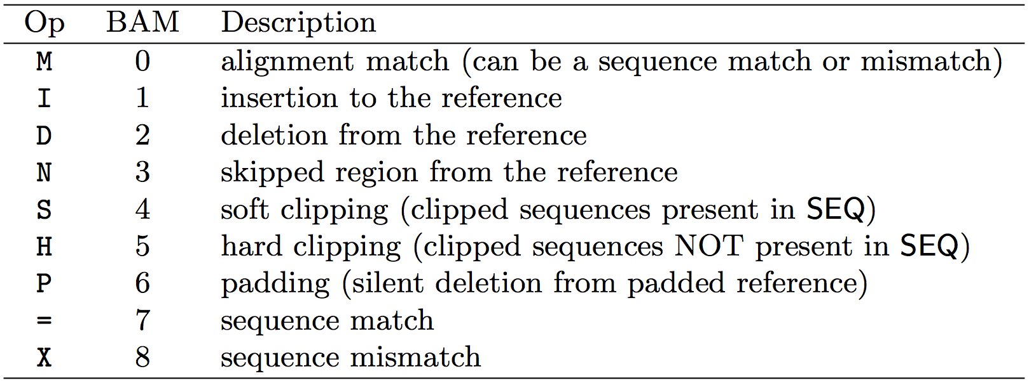
CIGAR strings explained
The CIGAR string is a sequence of base lengths and associated ‘operations’ that are used to indicate which bases align to the reference (either a match or mismatch), are deleted, are inserted, represent introns, etc.
e.g. 81M859N19M
A 100 bp read consists of: 81 bases of alignment to reference, 859 bases skipped (an intron), 19 bases of alignment

Slide 29
Introduction to the BED format
When working with BAM files, it is very common to want to examine a focused subset of the reference genome
e.g. the exons of a gene
These subsets are commonly specified in ‘BED’ files
https://genome.ucsc.edu/FAQ/FAQformat.html#format1
Many BAM manipulation tools accept regions of interest in BED format
Basic BED format (tab separated):
Chromosome name, start position, end position
Coordinates in BED format are 0 based

Slide 30
Manipulation of SAM/BAM and BED files
Several tools are used ubiquitously in sequence analysis to manipulate these files
SAM/BAM files
samtools
bamtools
picard
BED files
bedtools
bedops

Slide 31
Genome annotation resources
VEP
ANNOVAR
BioMart
UCSC Variant Annotation Integrator

Slide 32
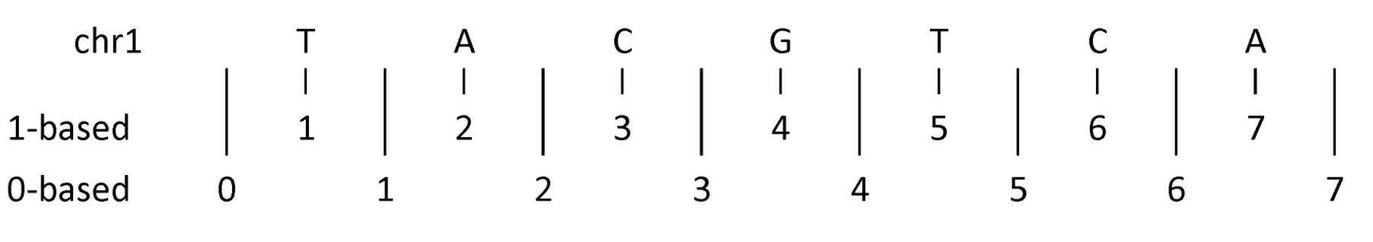
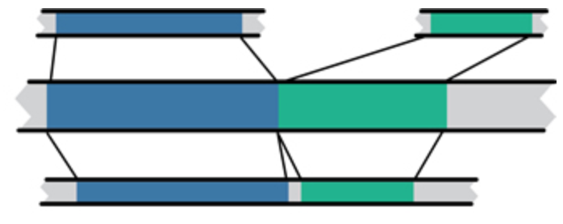
Common problems
Genomic coordinate systems
1-based vs. 0-based
Differences in carriage returns
Genome builds
And annotation builds
“Liftover” tools
Mouse mm10
Human hg19
Human GRCh37

Slide 33
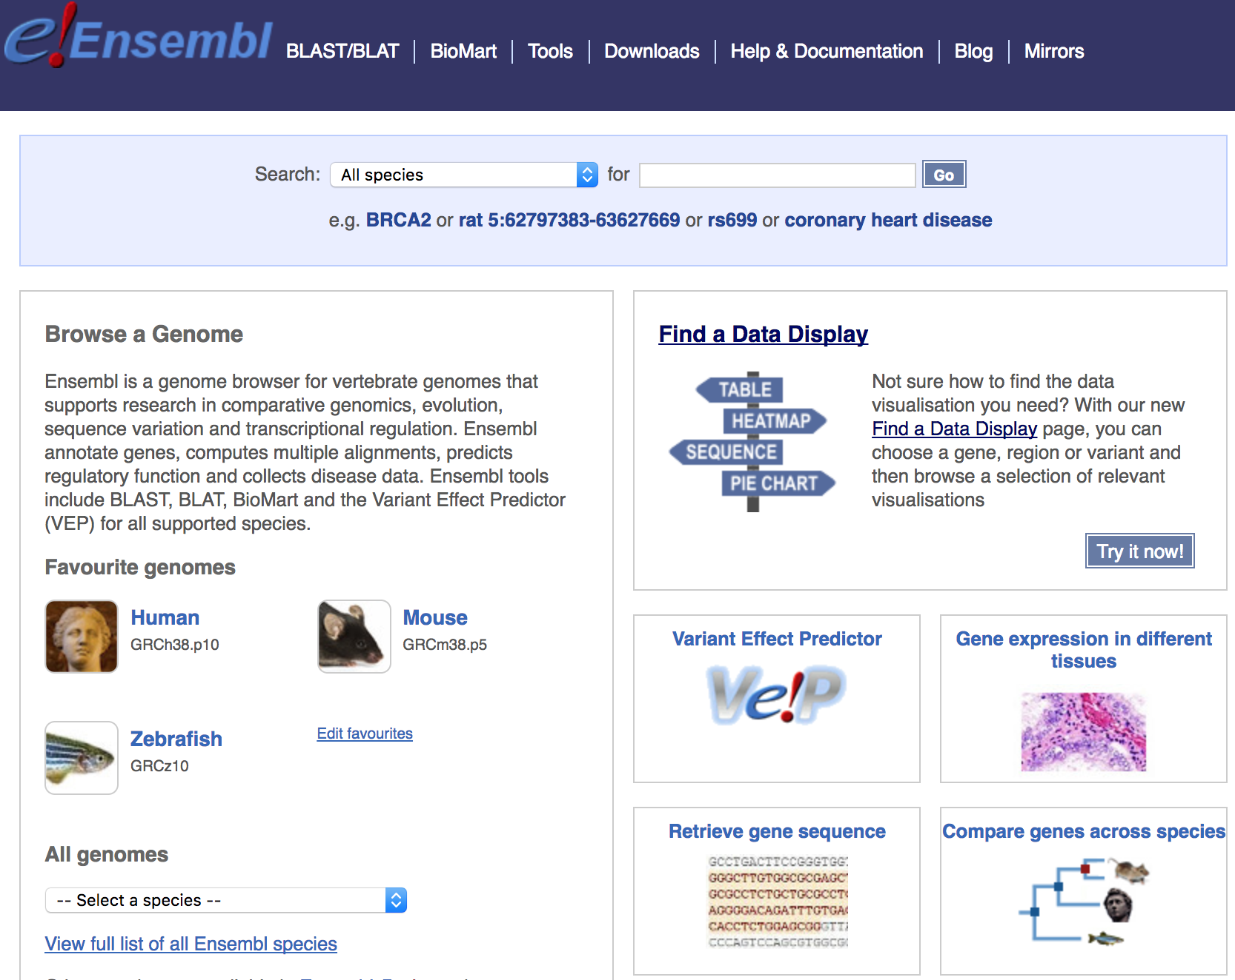
Genome browsers - Ensembl

Slide 34
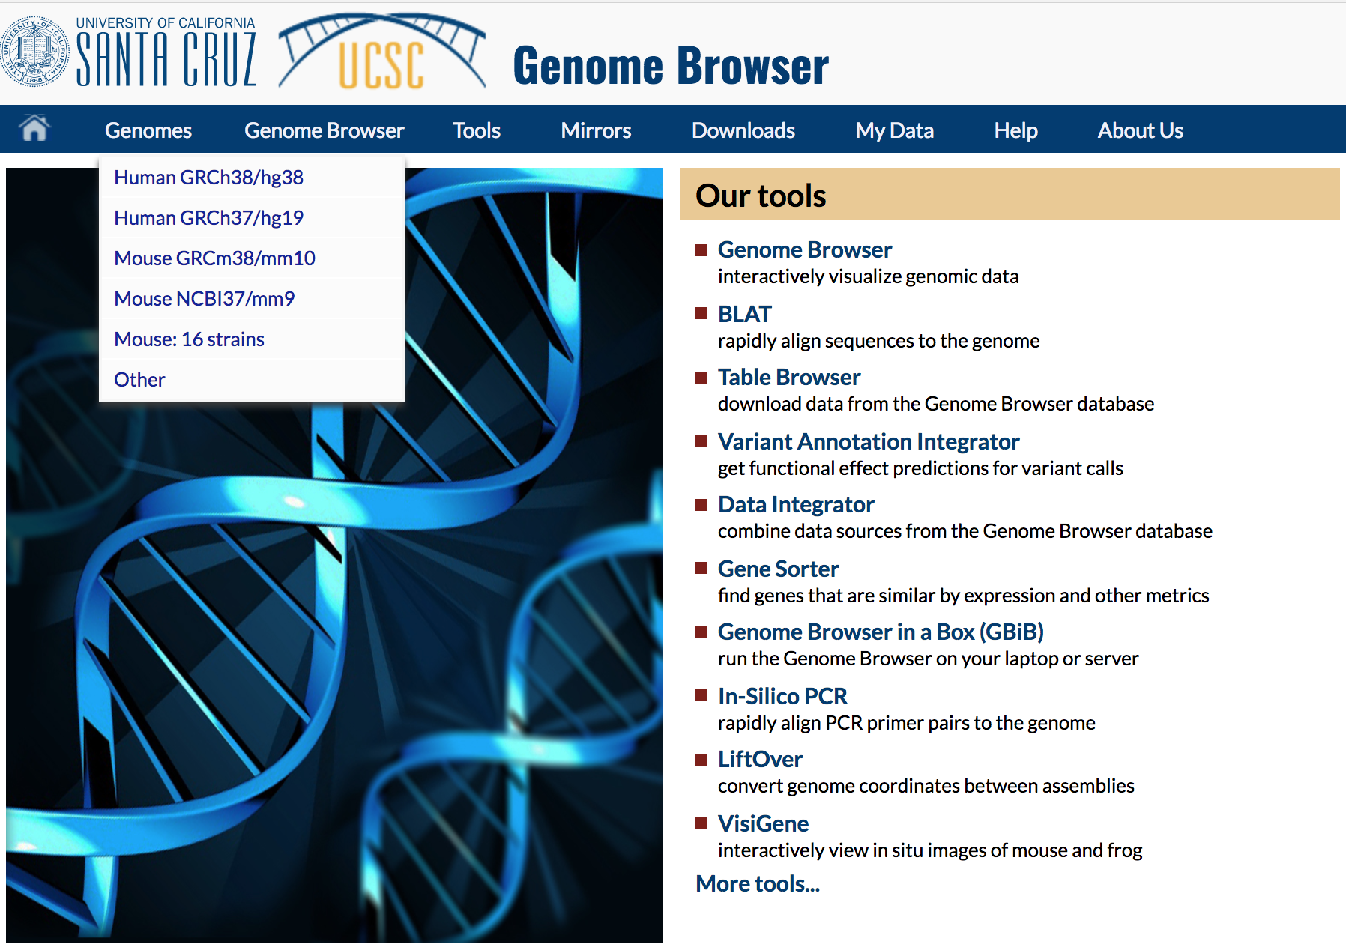
Genome browsers - UCSC

Slide 35
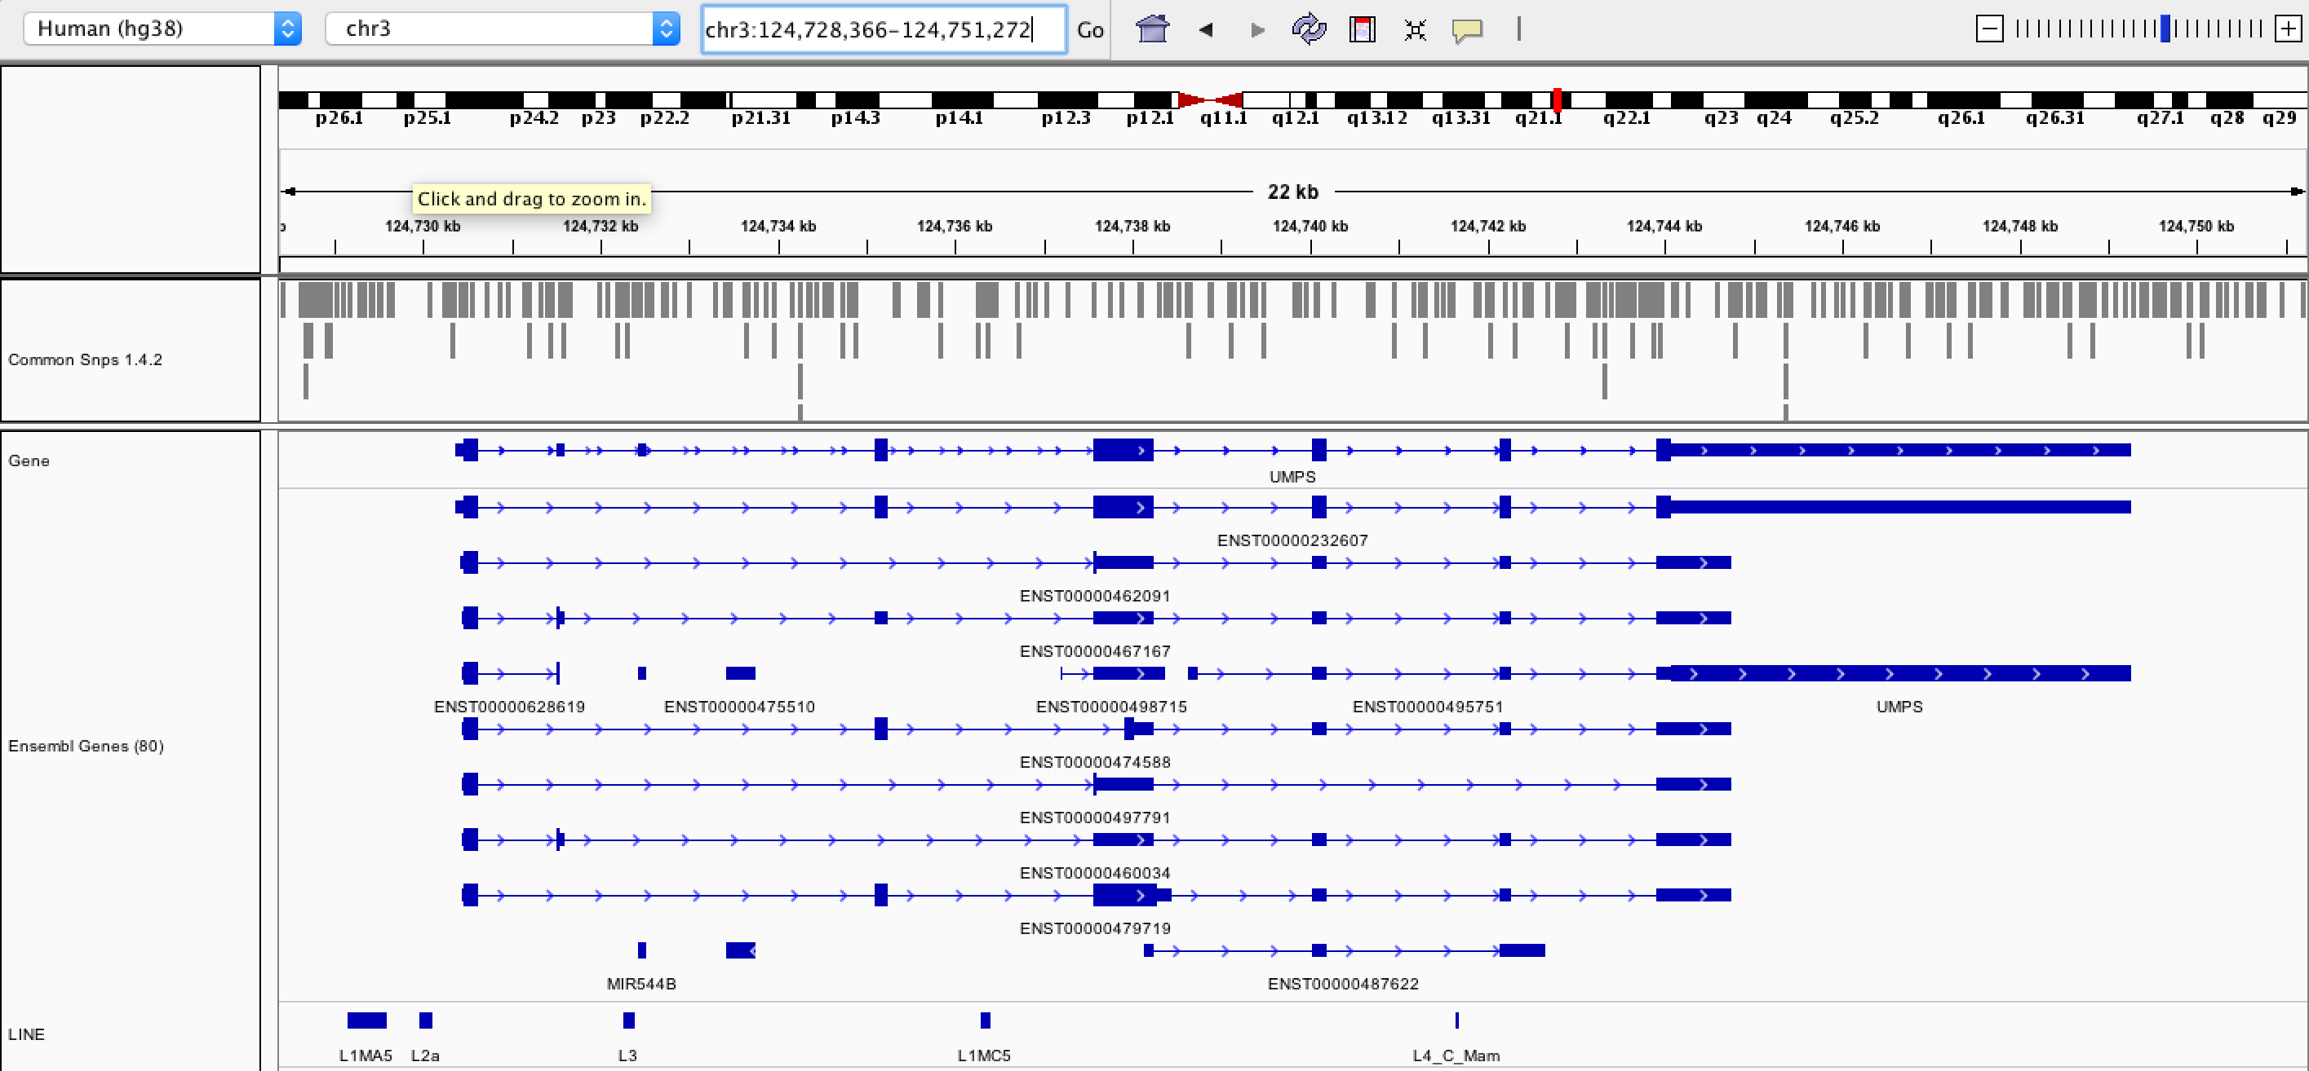
Genome browsers - IGV

Slide 36
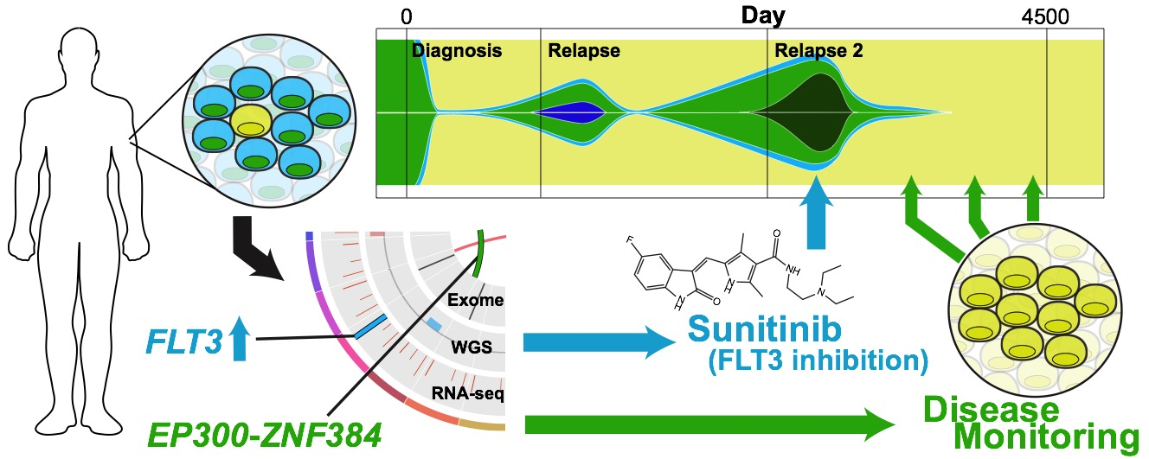
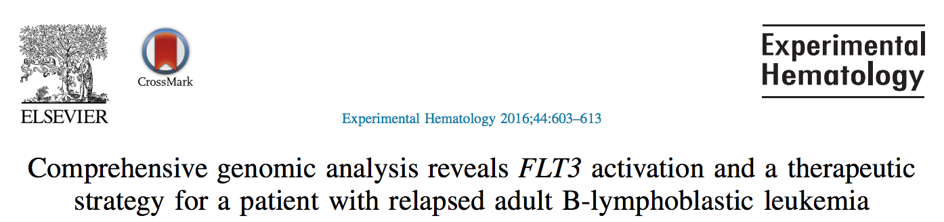
An example precision medicine exercise
Griffith et al. 2016
Kilannin Krysiak

Slide 37
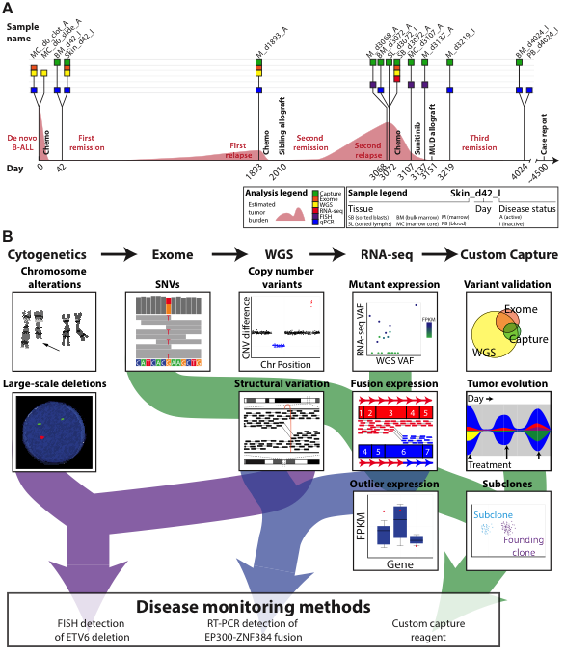
Case history for ‘ALL1’
We ultimately profiled 18 samples from nine time points (bone marrow biopsies) throughout disease progression to better understand the evolution of this tumor
Notes:
The first case is ALL1. This case is ongoing now for ~13 years.
Brief case history
Age 25: Initial presentation of classic pre B-ALL. Standard induction, consolidation, and 2 years of maintenance therapy.
Age 30: 1st relapse. Complete response obtained with salvage, consolidation with a matched sibling allo transplant; very mild GvHD.
Age 33: 2nd relapse, CNS involvement. Salvage chemo reduced, but did not eliminate the tumor. A second transplant was therefore unlikely to work.
At this point we sequenced sorted blasts obtained from the 2nd relapse and attempted to find something actionable

Slide 38
Comprehensive and integrative analysis was performed
Kilannin Krysiak
Notes:
As a proof-of-principle we took a very comprehensive approach. Though we balanced this with the need to complete data generation and a first version of the analysis quickly (41 days from receipt of sample to return of information).
By this time (2nd relapse), the patient had an extensive cytogenetics workup. To this we added exome, whole genome and RNA-seq.
Based on the WGS data we also created a custom NimbleGen capture reagent to cover all SNVs in the patient.
We used these data to identify SNVs and Indels, copy number variants, SVs, expressed variants, fusions, and outlier gene expression events.
The custom capture data was used largely to monitor disease burden in bone marrow samples obtained subsequent to the second relapse (and historical samples that were previously banked).

Slide 39
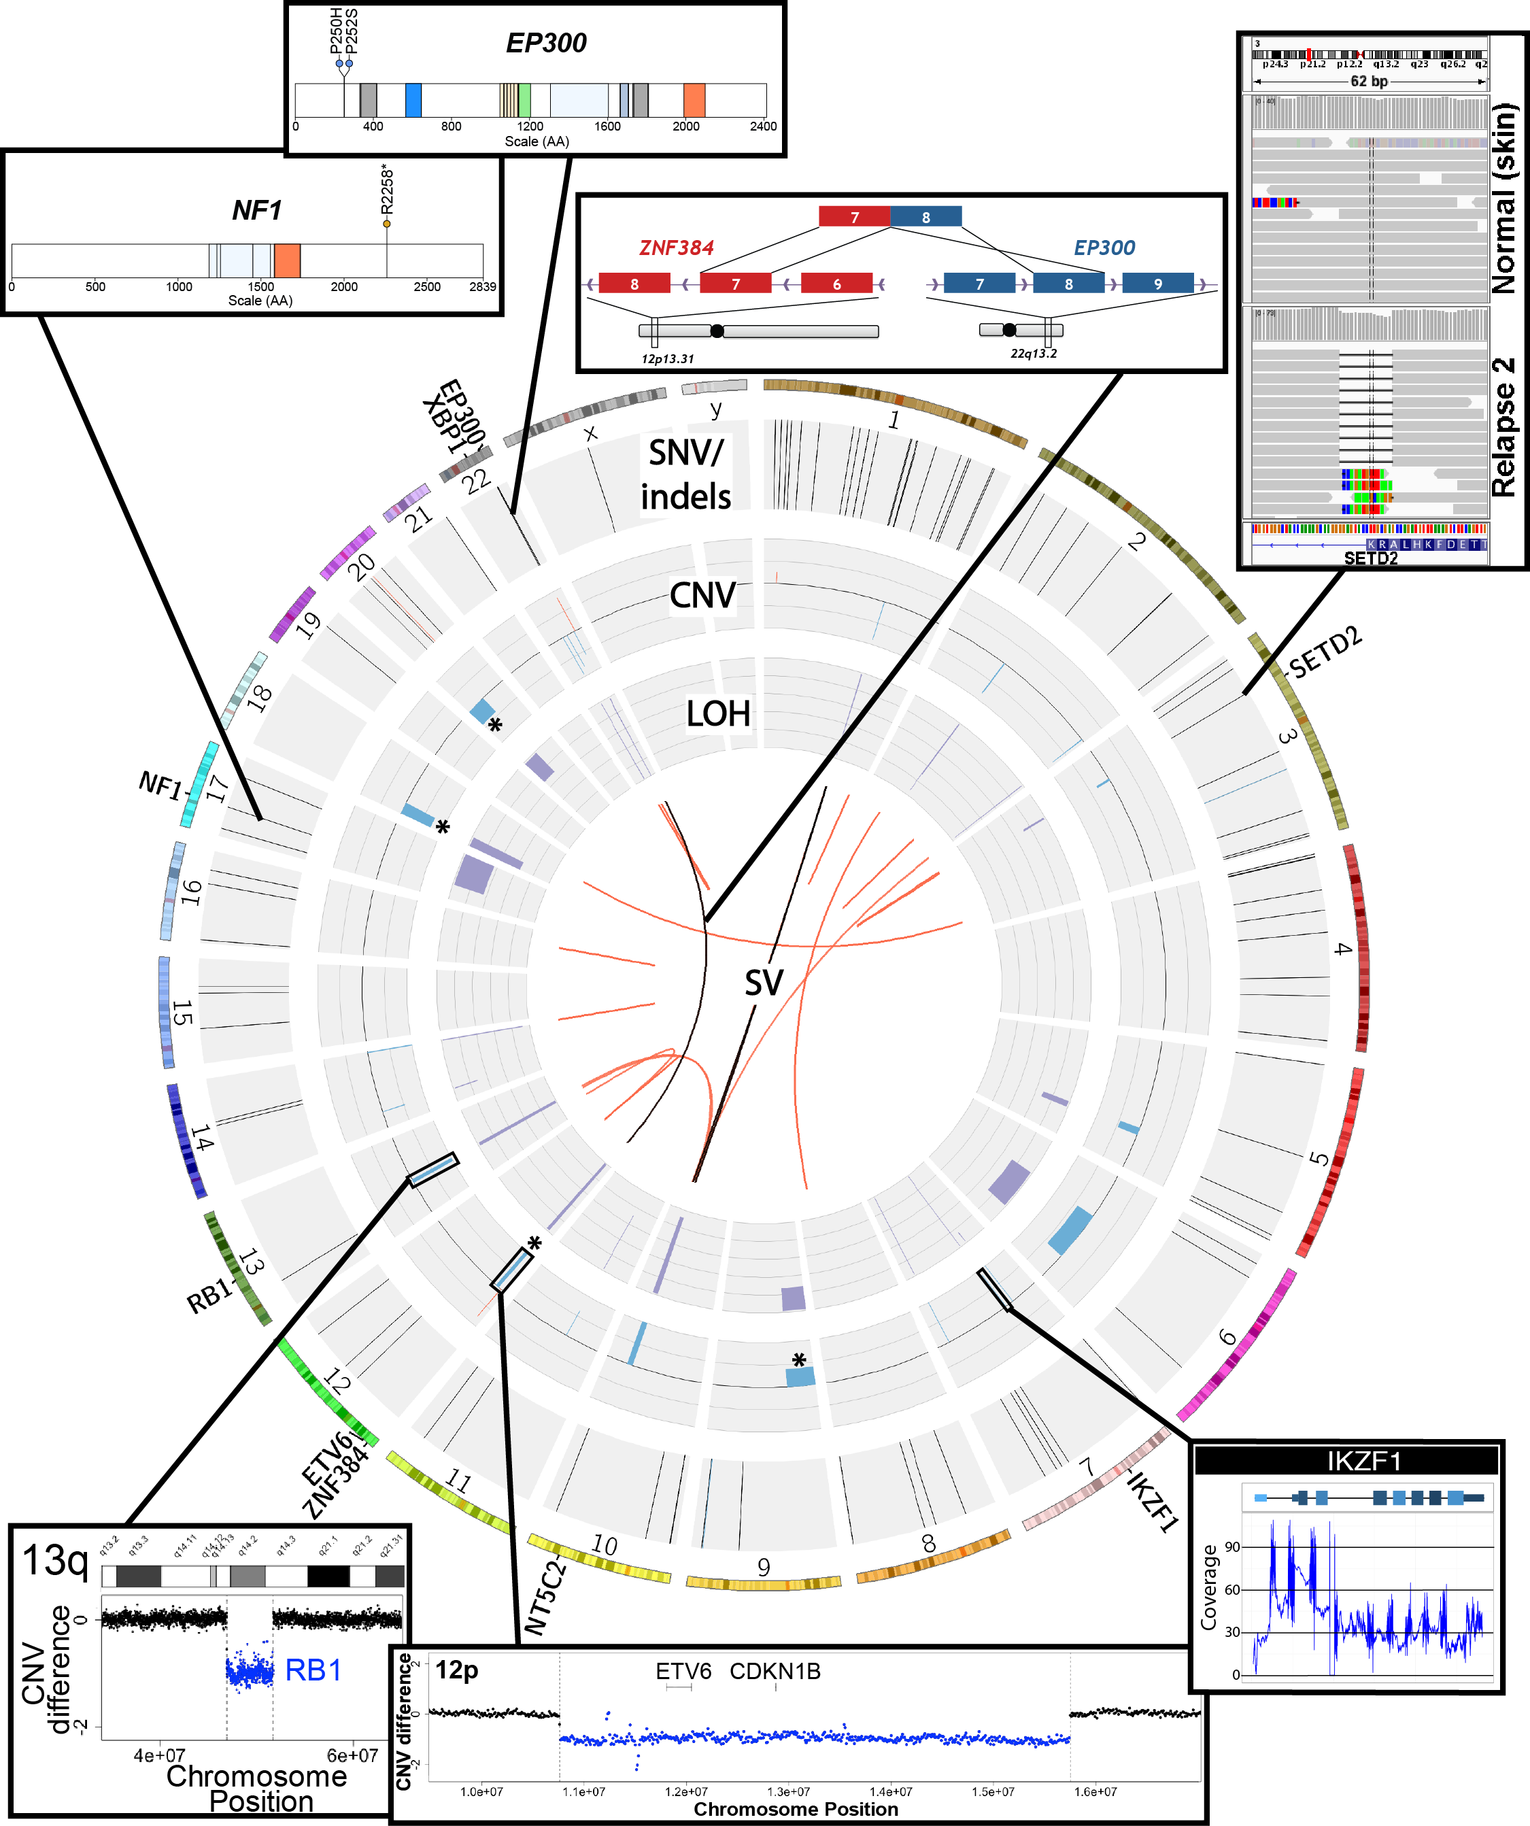
A very complex tumor genome was characterized
EP300 p.P250H
EP300 p.P252S
NF1 p.R2258*
NF1 LOH
SETD2 p.R2510fs
SETD2 focal deletion
XBP1 focal deletion
IKZF1 (Ikaros) focal deletion
RB1 large deletion
ETV6 large deletion
9p deletion (PAX5)
EP300-ZNF384 fusion
Notes:
Ultimately, an extremely comprehensive analysis was performed on this relapse tumor.
Many fascinating events were identified
The genome was characterized by a reasonable number of protein coding point mutations including those affecting EP300 and NF1.
While very little amplification was observed several rearrangements and both large and small deletions were apparent. These affected SETD2, XBP1, Ikaros, RB1, ETV6. SETD2 and NF1 were both hit twice.
An interesting EP300-ZNF384 fusion was identified.
At the time it was novel but has since been associated with other ALL patients.
While certainly interesting, none of these genomic events particularly suggested any clinical action.

Slide 40
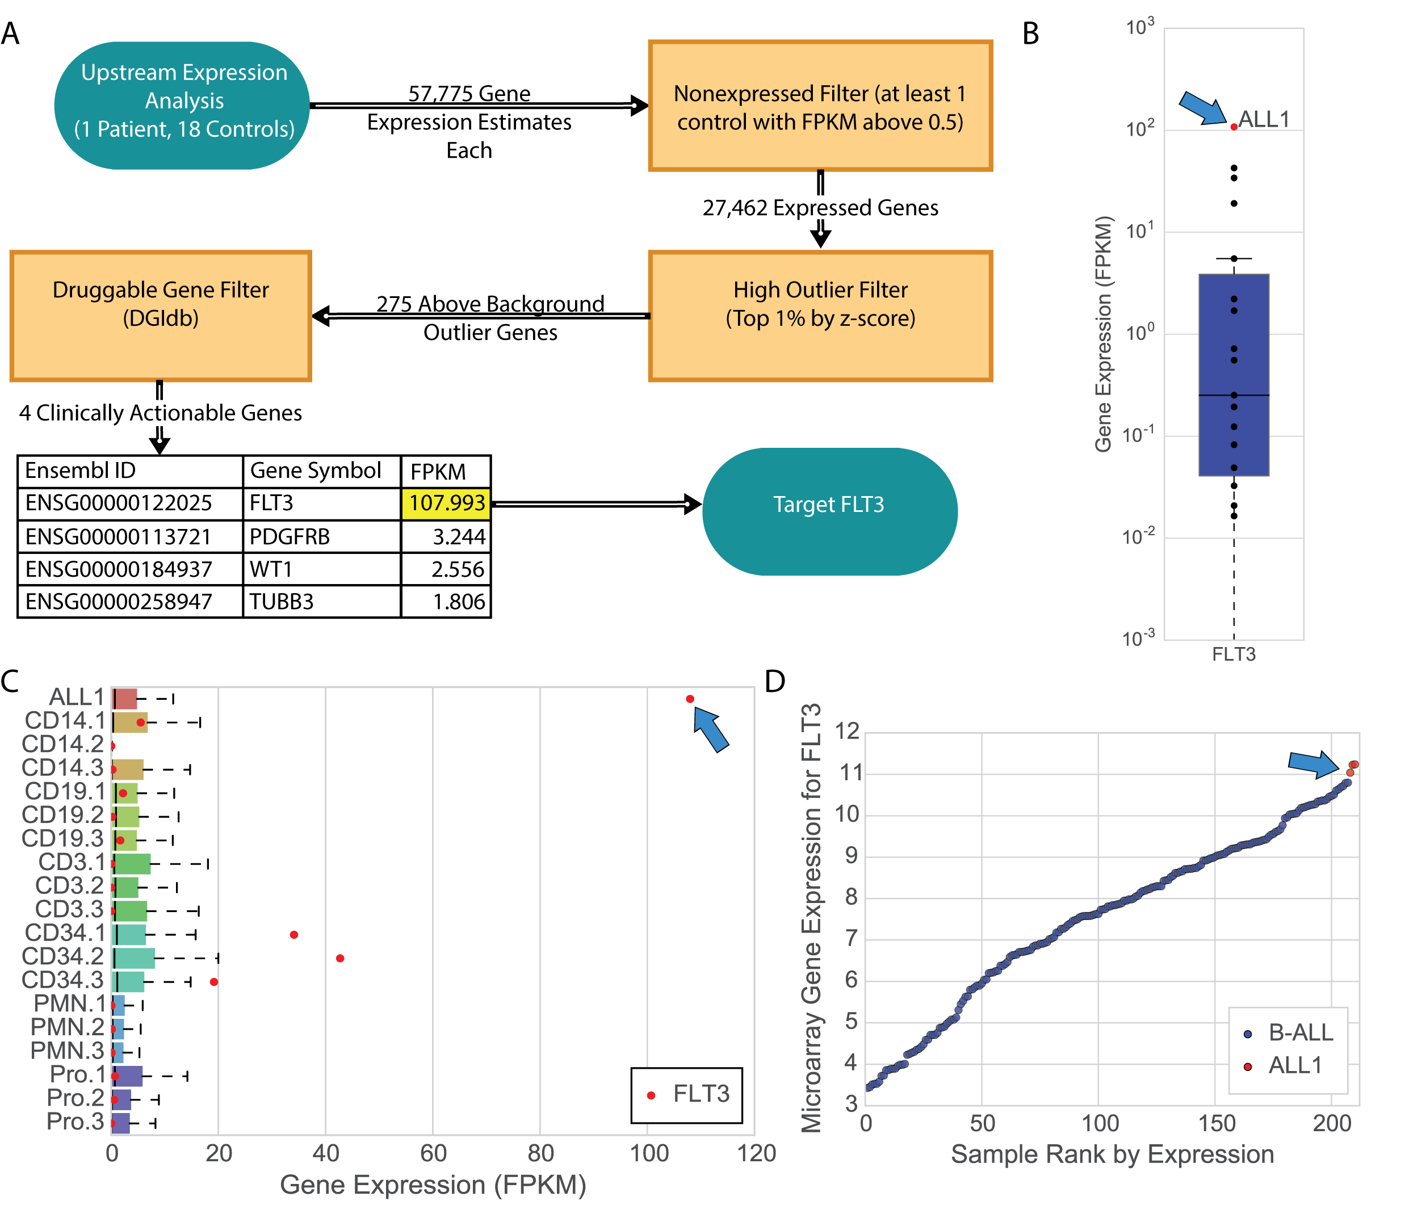
Transcriptome analysis was as important as genome analysis
Notes:
We next used our drug-gene interaction database (DGIdb) and a relatively simplistic expression analysis to identify the kinase FLT3 as the most promising candidate in this case.
FLT3 expression was an extreme outlier in this case with RNA expression as high as many housekeeping genes.
While we didn’t have a matched normal sample, FLT3 expression in tumor was high compared to various blood cell types, including CD34 cells sorted from a pool of healthy individuals.
Finally, even compared to 200 other B-ALLs, this tumor had the highest FLT3 expression.
Based on this observation the patient was started on a course of sunitinib.

Slide 41
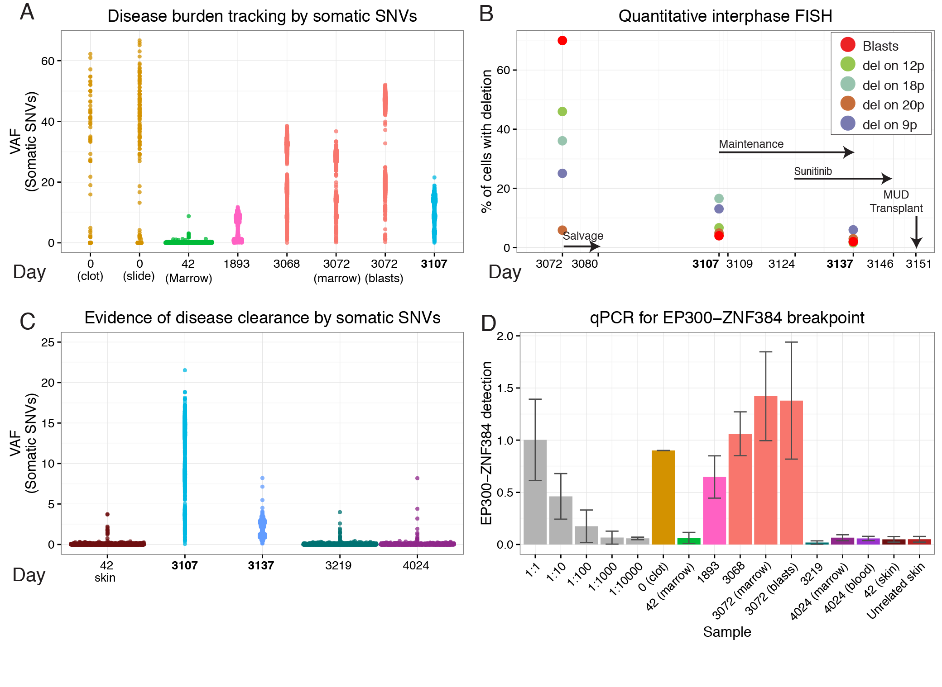
A personalized therapy and disease monitoring assays were developed
Zachary Skidmore
Notes:
For this case we also created three personalized assays for disease monitoring
our personalized capture reagent targeting all SNVs in this tumor (A-C on the left)
quantitative FISH (B)
an assay for the EP300-ZNF384 DNA breakpoint
Using these assays we were able to monitor disease and observe clearance of the tumor
While we are limited by the timepoints at which bone marrow biopsies were conducted it seemed that the sunitinib treatment was helpful in achieving clearance in advance of an allograft from a matched unrelated donor.
The most recent sample, taken at 4,024 days from initial diagnosis confirms that this patient remains in remission (4+ years after the MUD allograft).

Slide 42
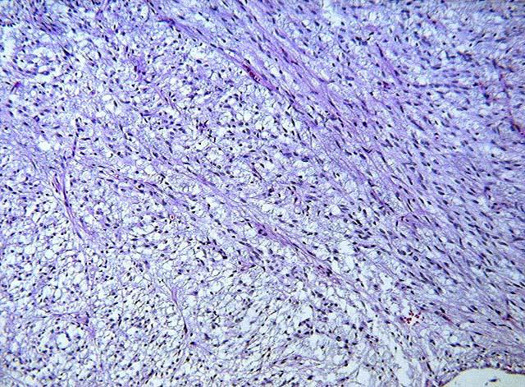
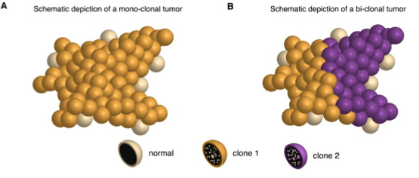
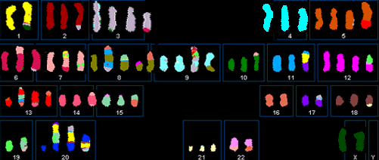
Visualization tumor clonality and evolution
Tumors are often impure
(contain normal cells)
Tumors are often genetically diverse collections of cells
Tumors may be aneuploid
Notes:
There are several factors that complicate sequencing and analysis of tumor genomes that are not encountered in germline sequencing projects.
Tumors are often impure, with normal cells mixed into the tumor cells. Tumors are often heterogeneous, containing complex genetically diverse collections of cells. Finally tumors can be highly aneuploid with major deviations from a diploid state
Each of these factors can make detection of somatic mutations more difficult and confound characterization of the clonal architecture of a tumor.

Slide 43
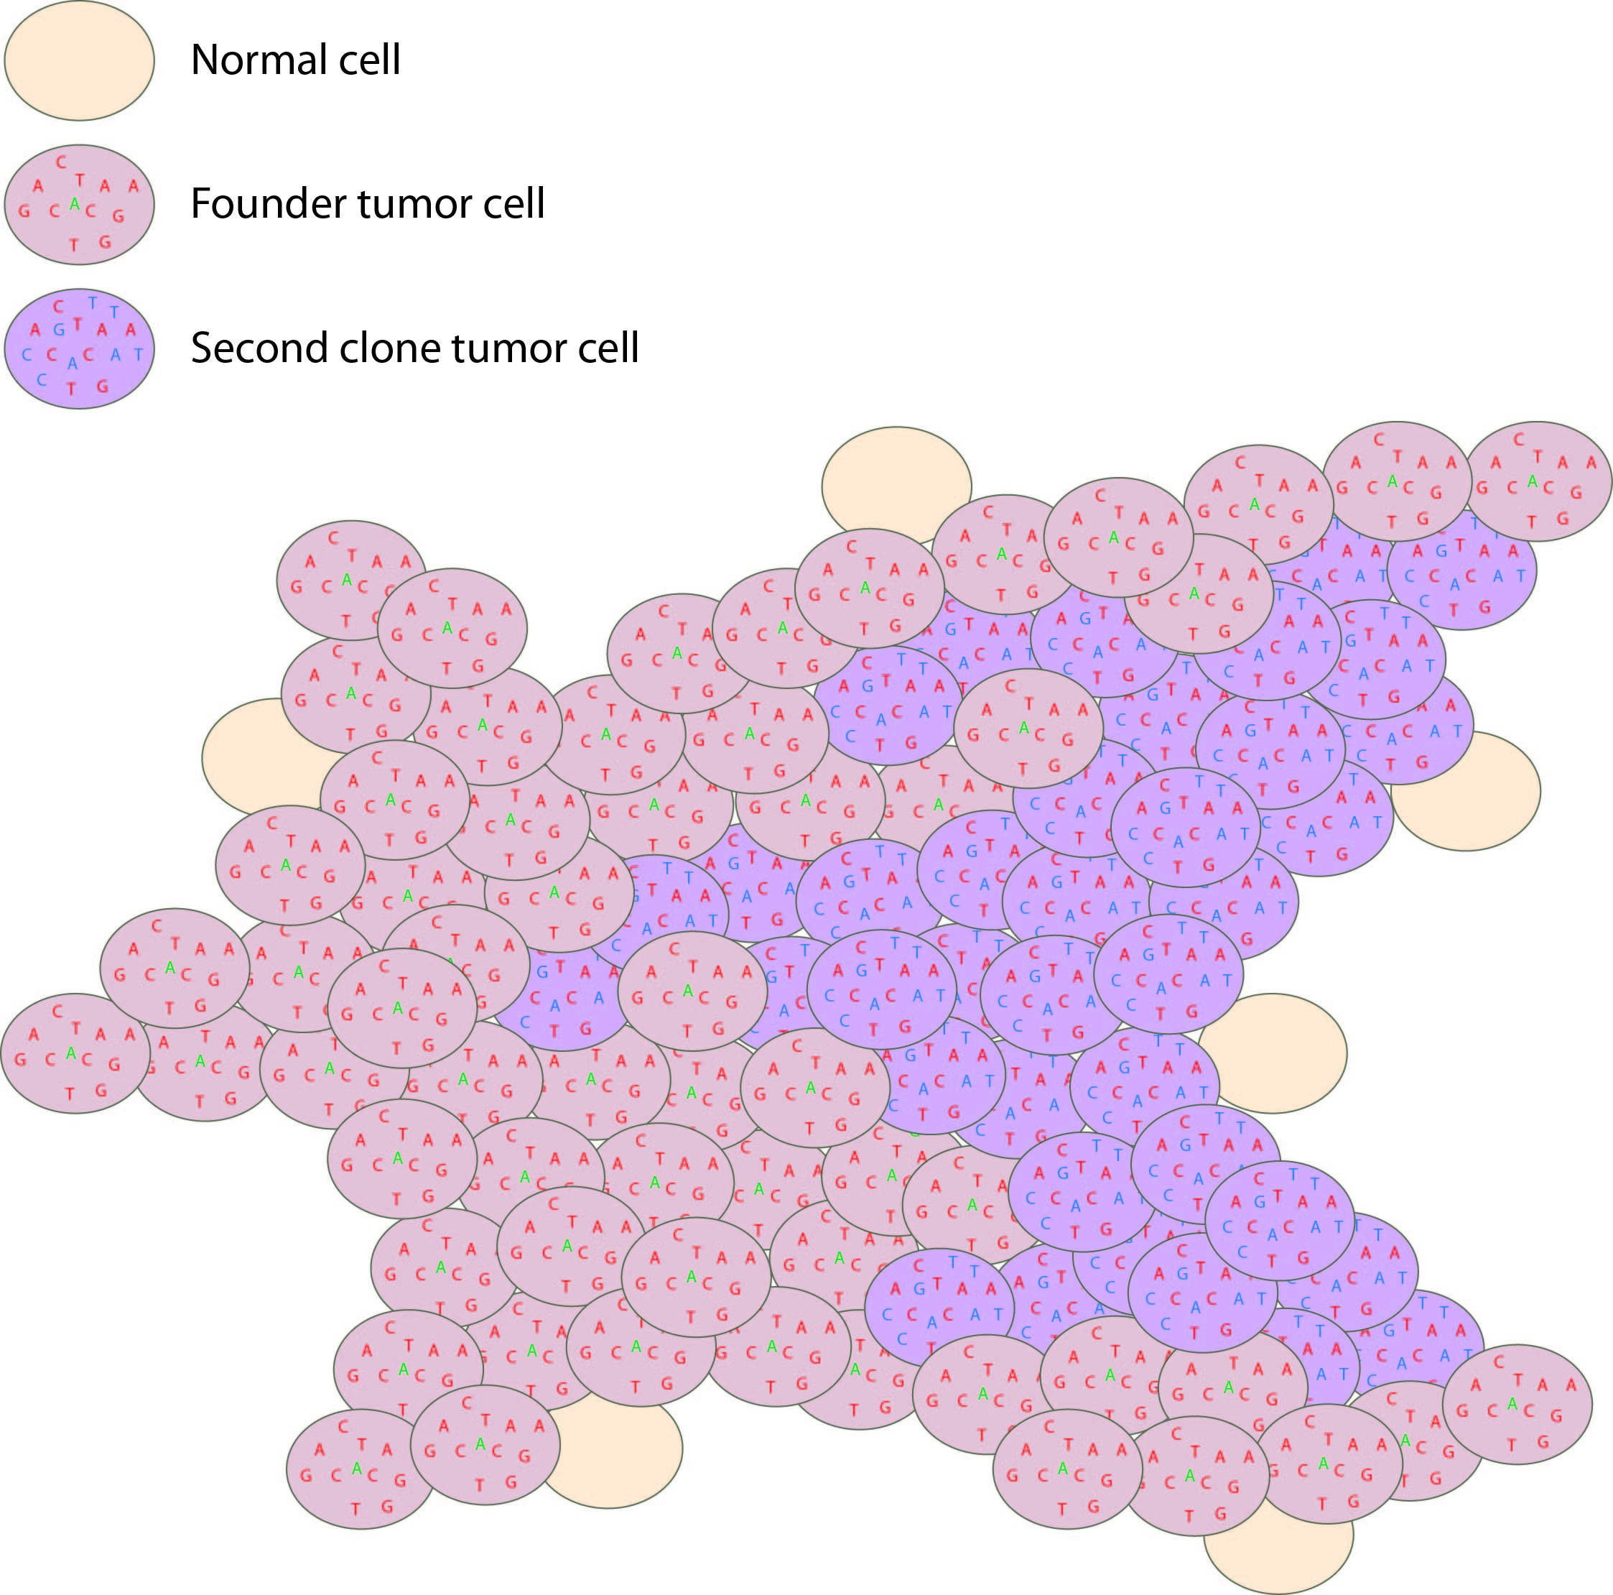
A ‘simple’ bi-clonal tumor
Tumor variant allele frequency
Proportion
NF1
Read coverage (X)
WGS data
Tumor variant allele frequency
Tumor variant allele frequency

Slide 44
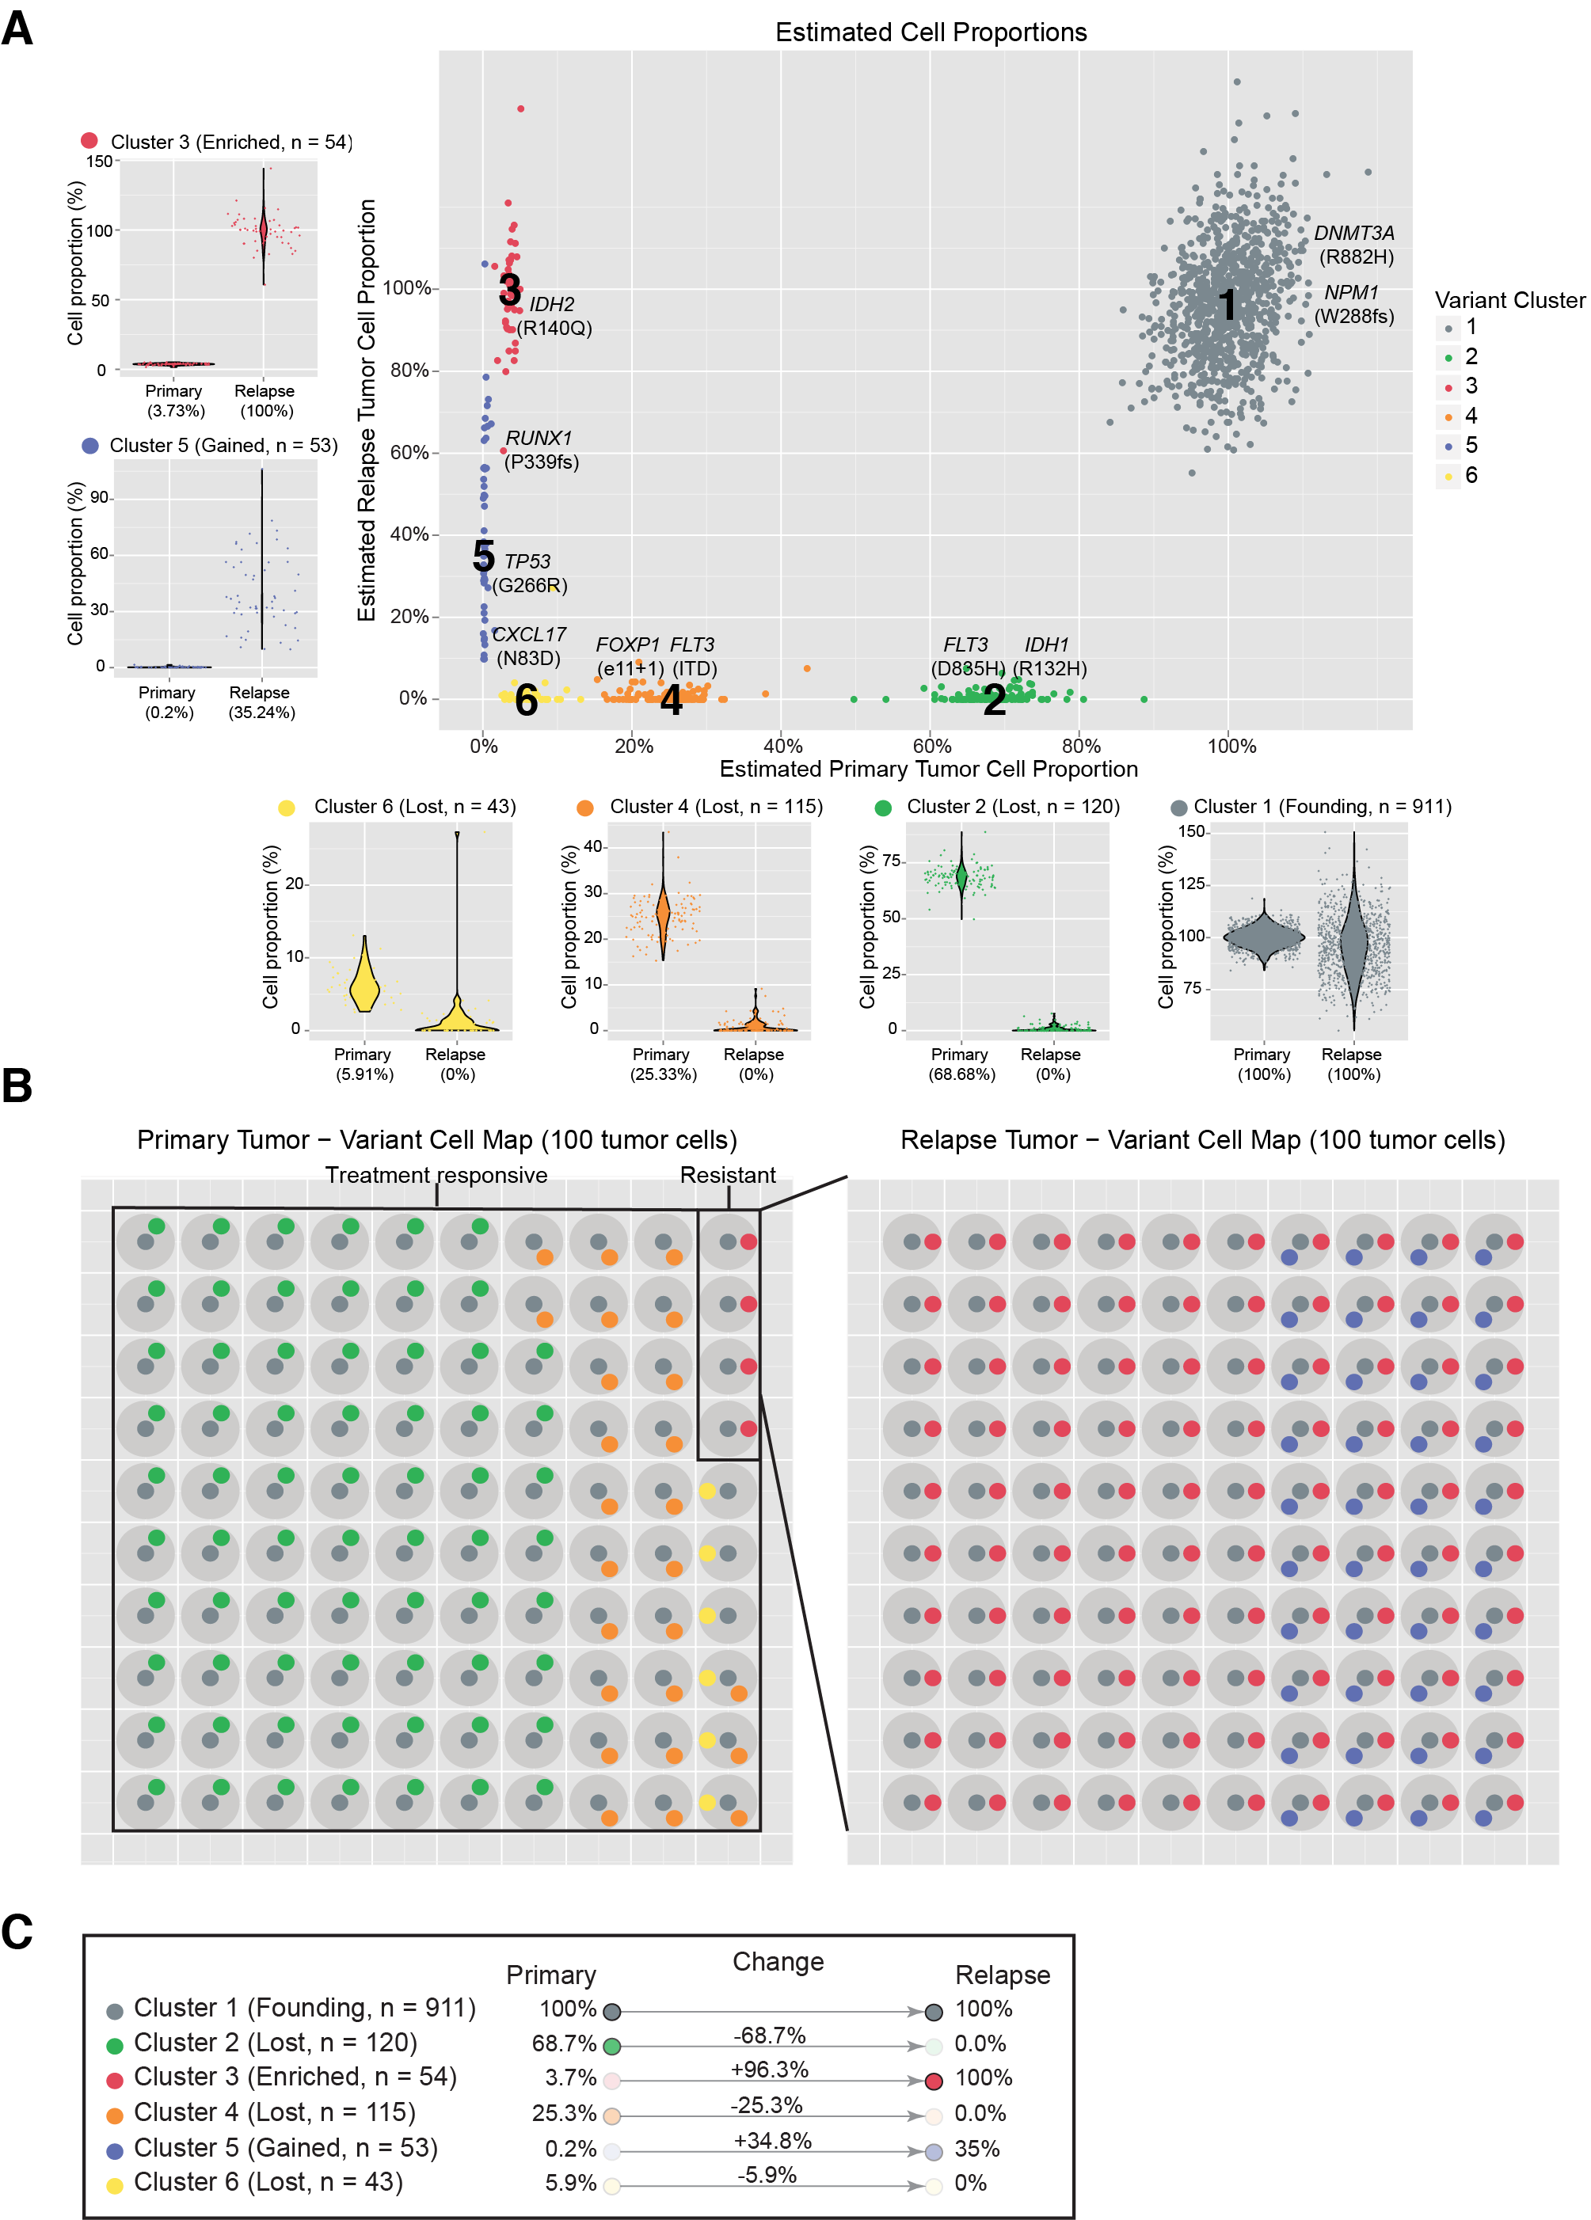
Clusters correspond to distinct cell populations
Notes:
If we overlay each of these mutations on the rest of the platinum variants and use a clonality inference tools like SciClone we can resolve 6 different sub-clones, each with a couple driver mutations present. Except sub-clone 6. Based on our experiences so far we probably still haven’t sequenced deeply enough to find a driver event in that sub-clone yet.
You can see how in each of the surrounding plots, a shift in VAF distribution is occurring between primary and relapse.

Slide 45
Using a “cell map” to represent the variant clusters in 100 hypothetical cells of a tissue

Slide 46
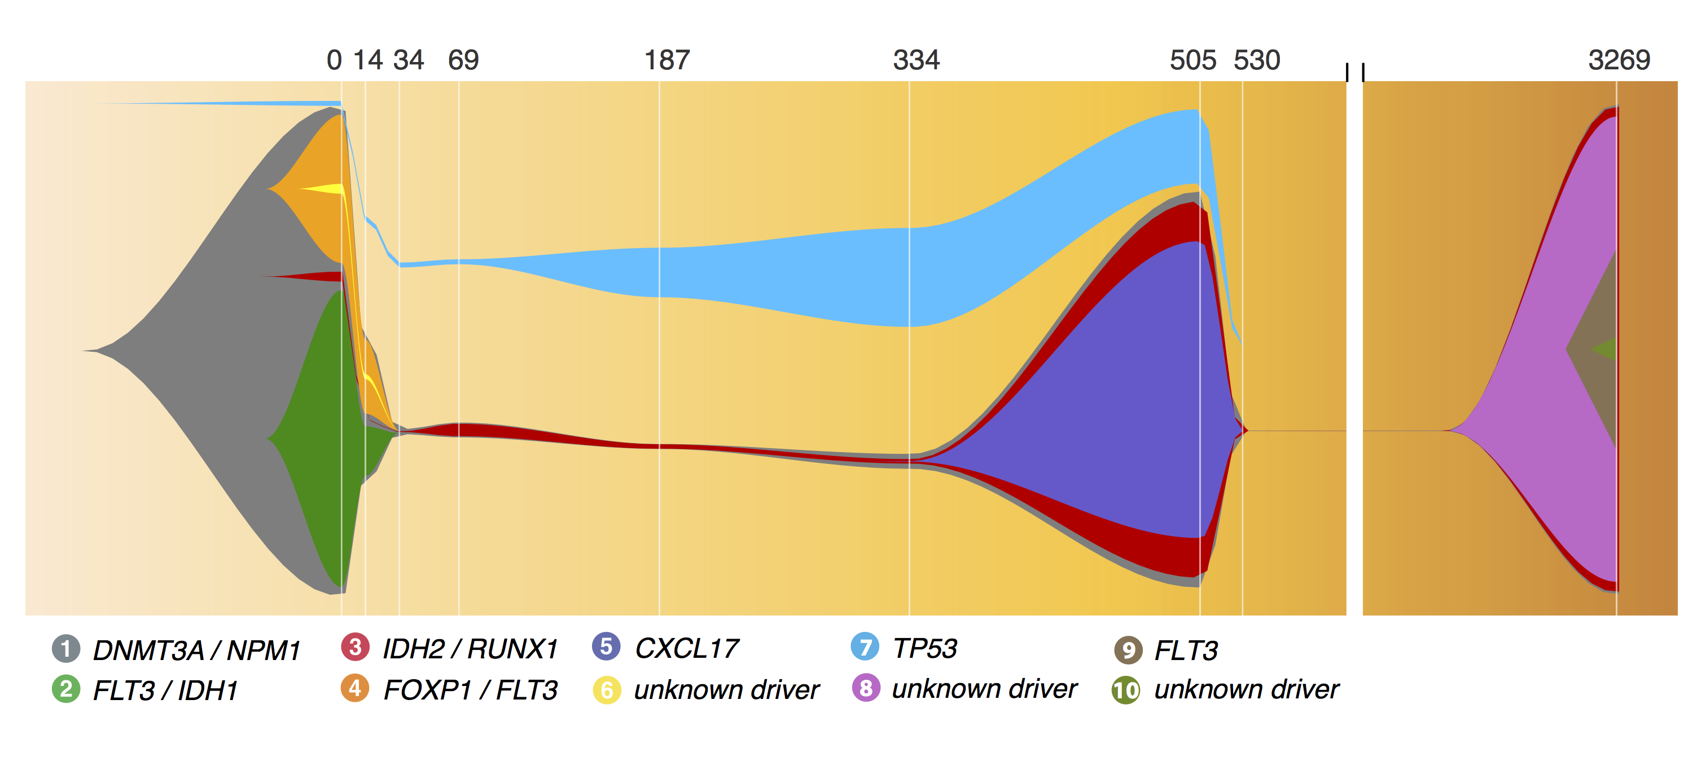
A ‘fish’ plot is used to represent sub-clones lost and gained over time

Slide 47
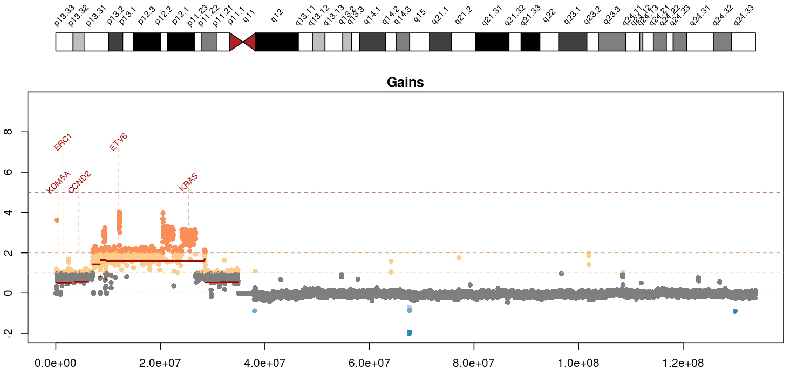
Visualizing copy number variation
Mean tumor-normal depth per 10kb window plotted
KRAS amplification in a metastatic breast cancer
Notes:
Whole genome data is exceptionally good a detecting copy number alterations in tumors. You essentially get a beautiful digital karyotype for each tumor. Here we see a complex amplification affecting KRAS and ETV6 and other critical cancer genes by both single copy and two copy gains.
We currently use cnv-hmm, CopyCat, and CnView for this kind of copy number analysis

Slide 48
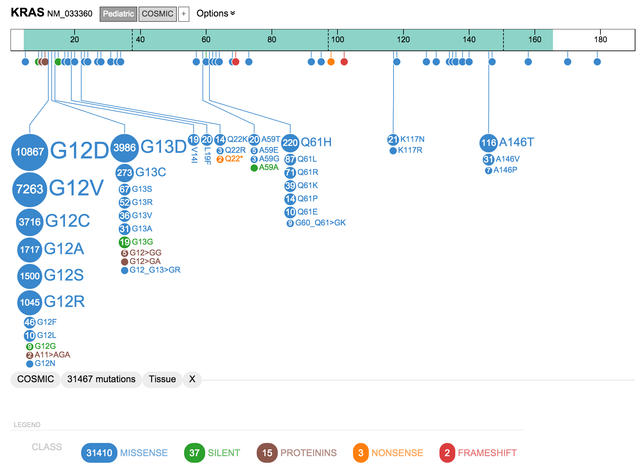
A ‘lollipop’ plot is used to variant recurrence in a gene

Slide 49
A ‘waterfall’ plot is one way to visualize the pattern of recurrence in a cohort
https://github.com/griffithlab/GenVisR

Slide 50
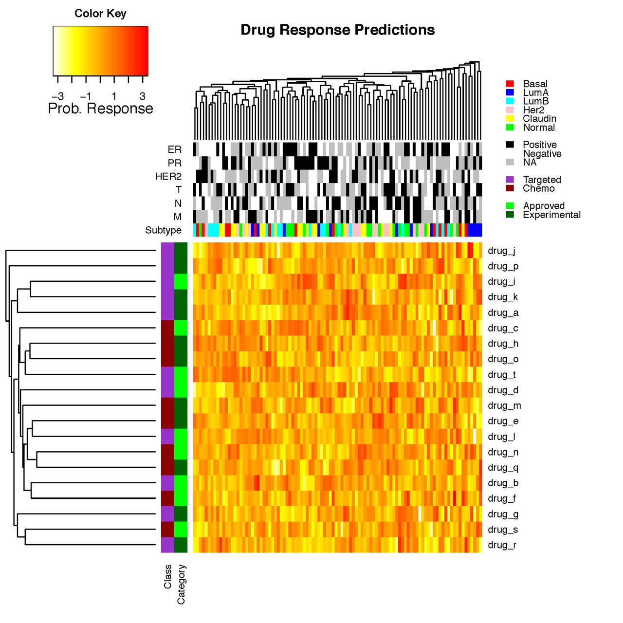
Heatmaps are a common way to simultaneously visualize multiple features of a dataset

Slide 51

GenVisR was created to help others make common genomic visualizations

Slide 52
Fundamentals of data visualization
Where to learn more about the art and science of visualization:
Collection of 40 Nature Methods articles on data visualization: “Points of View” Articles
Resources for choosing colors
http://colorbrewer2.org/
http://mkweb.bcgsc.ca/color/
Understanding and using Color Palettes
Credit to Martin Krzywinski for his extensive work in this area and many of the above resources

Slide 53
Best practices from this workshop
*Always* label axes
Consider readability of font size
Avoid vertical or angled text if possible
Avoid unnecessary use of color, point shapes, etc.
Chose colors wisely
If individual data points are being plotted and have started to really pile up on top of each other consider using a density function
Always be transparent about what data manipulation is taking place (e.g. log scale, filtering of outliers, etc.)

Slide 54
Best practices from the experts
Ten Simple Rules for Better Figures (Rougier et al. 2014):
Scientific visualizations should act as a “a graphical interface between people and data”. Try to follow these rules.
Know Your Audience
Identify Your Message
Adapt the Figure to the Support Medium
Captions Are Not Optional
Do Not Trust the Defaults
Use Color Effectively
Do Not Mislead the Reader
Avoid “Chartjunk”
Message Trumps Beauty
Get the Right Tool

Slide 55
Introduction to GenViz course site
www.genviz.org

Slide 56
Tutorial for module 1
www.genviz.org/course/#module-1

